Slide 2
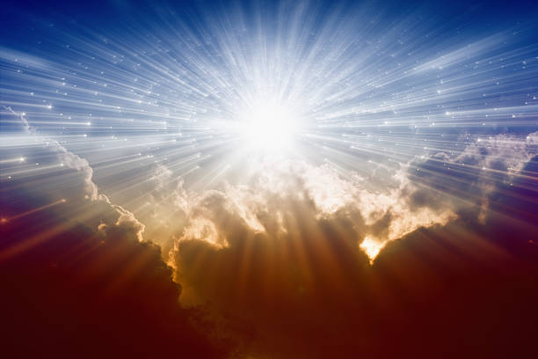
One is always in the presence of an omniscient and omnipresent God, Psalm 139:1-12
But let’s read about some folks who were specifically in the presence of God…
Ex.3:5-6; 19:9-25
2Chron.6:1 – 7:1a; 7:1b-3
Luke 9:18–36
Luke 5:1-11
Notes:
Note from Ex.3:5-6, “Do not come near… for the place…is holy… Moses hid his face, for he was afraid to look” ; Ex.19:10-11, “consecrate… wash… (to prepare); Ex.19:12-15, “set bounds… do not touch… shall be put to death” ; Ex.19:16-19, awesome sights and sounds, but the people could not go near or see; 2Chron.6:1-3, “Lord…would dwell in thick cloud…I have built for Thee a lofty house” ; 2Chron.6:13-14, Solomon prayed, “no God like Thee in heaven or on earth...” ; 2Chron.6:18, “will God dwell with mankind on the earth? Heaven and the highest heaven cannot contain Thee, how much less this house I have built.” 2Chron.7:1-3, “when Solomon finished praying, fire came down… consumed the burnt offering and the sacrifices; and the glory of the Lord filled the house… priests could not enter… because the glory of the Lord filled the Lord’s house… all the sons of Israel, seeing the fire…and the glory…bowed down on the pavement with their faces to the ground, and they worshipped and gave praise…” Luke 9:19-22, “Elijah… one of the prophets has risen again… the Christ of God… the Son of Man must suffer…be rejected…and be killed… and be raised up…” Luke 9:28-26, “face became different…clothing became white and gleaming… two men were talking with Him…. Moses and Elijah… appearing in glory… were speaking of His departure which he was about to accomplish… they saw His glory...and the two men standing with Him… (Peter’s proposal to build three tabernacles)… a cloud formed… overshadowed them…afraid as they entered the cloud… ‘This is My Son, My Chosen One; listen to Him!’… they kept silent.” Luke 5:8, When Peter saw the miracle Jesus performed, he “fell down at Jesus’ feet…’Depart from me… I am a sinful man, O Lord!”

Slide 3
What are we to glean from all of this?
Our God is awesome God of stunning glory and infinite power!
Being in His specific presence is awe-inspiring, spectacular... and terrifying!
It has and should evoke gratitude, praise, fear, extreme humility, and genuine worship.
Though the means and methods of worshipping Him have changed, Heb.7:12; 8:13; 9:1ff...
God hasn’t, doesn’t, and won’t, Mal.3:6; Heb.13:8.

Slide 4
Should we then be afraid/terrified when we are in God’s presence for worship, praise, and prayer?
No, because...
We have a sympathetic High Priest, Heb.4:14-16
And through Him/His blood, we have been granted confidence to enter the holy place, Heb.10:19-25
UNLESS we trample Him under foot and regard as unclean His sanctifying blood by continuing in willful sin, Heb.10:26-29
THEN we should be afraid/terrified, Heb.10:30-31

Slide 5
So... (also from Heb.10)
Remember your enlightening, vv.32-34
Don’t throw away your confidence, v.35
Endure in doing the will of God, vv.36-38
All in/with/through faith, v.39 – 11:1ff
But always remember to where you have come and Whom you serve, Heb.12:18-29!

