Slide 2
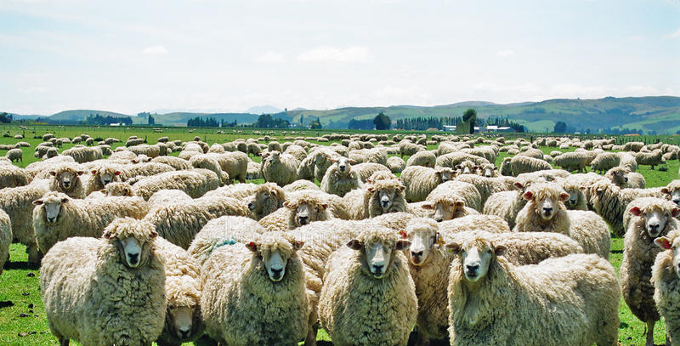
Duties of Shepherds
Having considered the qualifications, it only seems fair to examine what’s expected of those who desire the office.
Generally, and as implied by the descriptive names…
Elders (presbuteros) use their wisdom and experience to teach and lead;
Overseers (episkopos) look at/over, consider, superintend, and govern; and,
Shepherds (poimen) guide, provide, and protect the flock.
But let’s look more specifically at what it means to be an Elder, Overseer, and Shepherd…

Slide 3
Duties of Shepherds
The Elder’s Duties can be broken down into Categories:
Personal Duties:
Acts 20:28a, He must first use his wisdom and experience to continually teach, oversee, and shepherd HIMSELF in order to help others, Matt.7:3-5; 2Cor.13:5.
Jas.1:22-25, He must also constantly compare and correct HIMSELF with the perfect mirror of God’s Word in order to be able to help others.
Acts 20:32, And he must continue to personally grow in order to be an example to (1Pet.5:3) and help others grow.

Slide 4
Duties of Shepherds
The Elder’s Duties can be broken down into Categories:
Oversight Duties:
1Pet.5:4, His oversight must be properly understood- he is an overseer not the Owner; Titus 1:7a, “as God’s steward,” cf. John 10:12-13 and 1Cor.4:1-2;
1Pet.5:2, His oversight must be properly motivated- “not under compulsion” and “not for sordid gain” but “voluntarily, according to the will of God” and “with eagerness;” and,
1Pet.5:3, His oversight must be properly administered- “not lording over” but exemplary.

Slide 5
Duties of Shepherds
The Elder’s Duties can be broken down into Categories:
Teaching Duties:
Quick Question: “Who, besides your parents, do you remember teaching and influencing you in and with God’s Word?”
Did any Elders come to mind? If not, “Why not?”*
Heb.13:7,17, Perhaps they should have!
Being “able to teach” (1Tim.3:2) is not just a qualification, it’s part of the job for an Elder, cf. 1Thess.5:12-13; Titus 1:9-11.
Notes:
*Obviously, it could be that you grew up in a congregation that didn’t have Elders; or that you didn’t have anyone that taught you the word. But it is likely that someone led you to faith in Christ. Was it an Elder?

Slide 6
Duties of Shepherds
The Elder’s Duties can be broken down into Categories:
Ministering Duties:
The idea of ministering is that of meeting needs;
Not “wash my car/pickup” needs! cp. Acts 6:2,4
But spiritual needs, Acts 20:35; Heb.12:1-11,12-16.
Please understand from Jas.5:14-15*: 1) “sick” probably includes if not pertains to spiritual condition; 2) supposed to “call for the elders;” 3) Elders at this time typically possessed miraculous power; 4) Elder today do not possess this power; and, 5) Elders today should still minister to and pray for the “sick”- especially those spiritually “sick”!
Notes:
*Likely devote an entire lesson to vv.13-20 at some point, but for now will just deal with matters specific to Elders duties.

Slide 7
Duties of Shepherds
The Elder’s Duties can be broken down into Categories:
Shepherding Duties:
Acts 20:28, “be on guard for all the flock” requires…
Him to know the flock, cp. John 10:3-4a; their individual needs, weaknesses, and abilities; and,
The flock must let themselves be known- can’t hide, shy away, and refuse the time and ability to be known by him; they must trust, provide access, and be willing to hear and follow, cp. John 10:4b-5.
How else can he be a shepherd to them? John 10:14

Slide 8
Duties of Shepherds
The Elder’s Duties can be broken down into Categories:
Shepherding Duties: (continued)
John 21:15-17, “Tend”ing/“Shepherd”ing requires…
Having the good of the flock in mind, Jn.10:13;
Making sure they have proper food, Ps.23:2; 1Pet.2:1-2; Heb.5:12-14;
Seeing and caring for individual sheep as well as the flock, Luke 15:4-7;
Leading from the front, John 10:27 (to be thermostats not thermometers); and,
Protecting the flock from wolves- both from within and without, Acts 20:29; John 10:11-13.

Slide 9
Duties of Shepherds
The Elder’s Duties can be broken down into Categories:
Exemplary Duties:
1Pet.5:3b, To be an “example to the flock” …
Of a husband, Eph.5:23,25;
Of a father, Eph.6:4; Col.3:21;
Of a neighbor, Luke 10:30ff;
Of a teacher, 2Tim.2:24-26;
Of a business man, Col.3:22 – 4:1;
Of a Christian, 1Tim.4:12b; and,
Of a worker in the kingdom, John 15:8.

Slide 10
As you can clearly see…
Being a scriptural Presbyter/Elder, Bishop/Overseer, Shepherd/Pastor is not only a BIG job, but one that comes with IMPORTANT responsibilities!
But it is also the most noble and needed task to which any man may aspire.
Those who do deserve our respect, support, encouragement, thanks, and prayers always!
Next time, we will wrap up this series by considering
“What Elders Can’t (and shouldn’t be expected to) Do For You/Us.”

