Slide 2
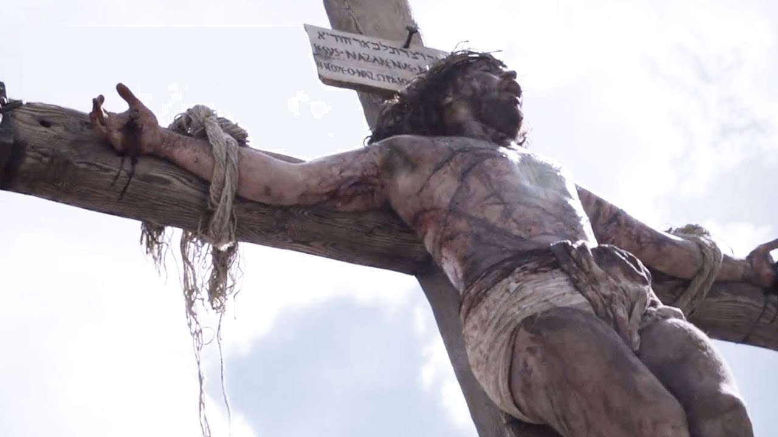
“The” Church…
Was purchased with the blood of Jesus, Acts 20:28
Was built by Him, Matt.16:18; with the inspired word (via “apostles and prophets”) of God as its “foundation,” Eph.2:20a; and Christ Himself as the “cornerstone,” Eph.2:20b
Operates with Christ as the “head,” Eph.1:22-23
Is accessed by faith, repentance, and baptism, Acts 2:36-38,40-41
Is composed of the saved of all time, Heb.12:23; it began in a sense on Pentecost in 33 A.D. as per Acts 2, but Jesus’ sacrifice also reached back to save the faithful of previous dispensations and covenants, Rom.3:25-26; Heb.9:15; 10:12

Slide 3
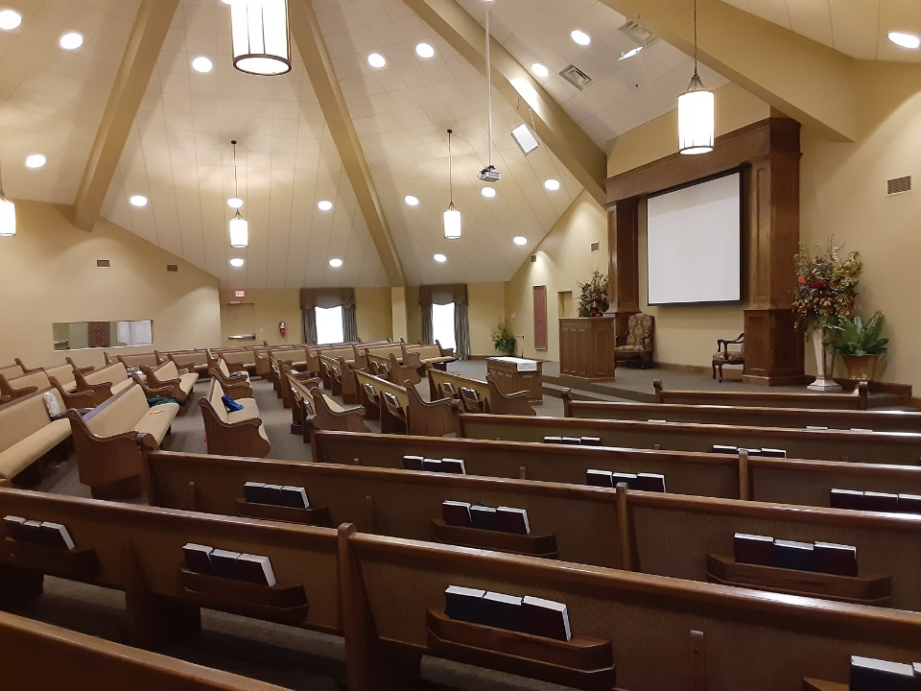
But “This” Church (the local body at Viking Drive)
Was/is financed with $$$$ from its members, 1Cor.16:1-2*
Originated/was built when area Christians (fellow members of “the” universal church) decided to ban together to work and worship at and in “this” local church, Acts 2:42-47
Still operates with Christ as its only “head” (executively, legislatively, and judicially), but has local “overseers and deacons” serving as “stewards” of Christ with/for “saints,” Phil.1:1; 1Pet.5:2-4; 1Tim.3:10b,13
Is accessed either by conversion and addition, Acts 4:4, or just by addition (for those already members of the “the” church by conversion), Acts 9:18,26-28
Is composed of the sum of all who have been added or subtracted (2Thess.3:6,14-15) over the years since its inception. But, as fallible overseers/stewards, we must admit the possibility of error regarding “this” church’s membership since we:
May have added/kept those we should not, 1Cor.5:1ff; or,
May have excluded/expelled those we should not, 3John 9-11.
“OK, so…
Notes:
* Obviously, all we have is provided by God, Jas.1:17; Acts 14:14:17; 17:28; and we are but stewards of all He provides; but the point I’m trying to emphasize here is to note that “this” local church was begun and is maintained by the free will contributions of members here.

Slide 4
What’s the Point?”
“The” (universal) church belongs to Christ; He bought, oversees, and grows and maintains its perfect membership and fellowship.
“This” (local) church still belongs to Christ (cp. Eph.1:22; 4:1,15), but it is OUR responsibility to:
Finance, 2Cor.8:1-5
Oversee, 1Pet.5:1-4
Grow and Maintain Fellowship, Rev.3:8; Acts 9:27; 1Cor.5:9-13
All in ways and means that please Him, Luke 12:42-44.

Slide 5
Now, what does it take for “this” local church to accomplish what the Owner desires and expects?
Each and every member needs to be:
Faithful- have a personal, active, and growing faith that is reaching toward full, Eph.4:11-16
Loyal- unquestionably so to God, His word, and one another, Acts 2:43-47
Devoted*- to the word, to fellowship, and to worship, Acts 2:42; as well as to one another, Rom.12:10
Steadfast (firm, unwavering), Immovable (steady, unshaken), and always Abounding (to overflow)- “in the work of the Lord,” 1Cor.15:58
Notes:
1 to adhere to and be devoted or constant to one; to be steadfastly attentive unto, to give unremitting care to a thing

Slide 6
Conclusions?
As stewards of the blessings of God, “This” church is…
Our responsibility- “we” are responsible for its particular successes and failures; in this regard, it’s “our” church. Do you feel this way?
Each one of us needs to accept and feel this responsibility personally; in this regard, it’s “my” church for each of us. Do you feel this way?
If so, great- our fellowship can move forward.
If not, then there’s something lacking in “our” or “your” fellowship here at Viking Drive. It is holding us/you back, and needs to be corrected.
We all need to be “all in” - are you?

