Slide 2
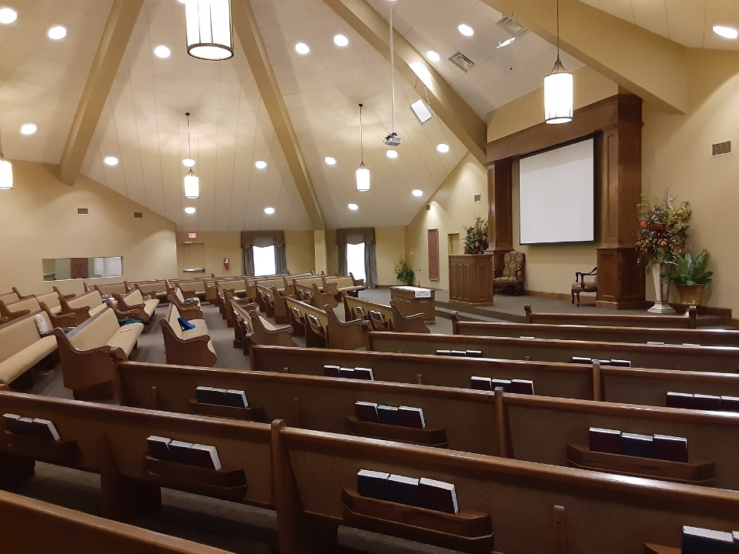
“What Makes the ‘Church of Christ’ Different?”
Our previous two lessons have shown that:
“Truth” is evidential, empirical, universal, and objective
Being “honest and sincere” in beliefs, practices, and worship is no substitute for “truth.” So finally, let’s consider...
“Truth” in application; how it should affect our belief and practice relative to the Church’s origin, organization, purpose, and methodology.
Notes:
Fair Warning: We’re going to be covering a lot of ground in this lesson, so I urge you to please get your Bibles ready to examine the Scriptures referenced as I will not be reading most of them with you for the sake of time.

Slide 3
“What Makes the ‘Church of Christ’ Different?”
“Truth” in Application relative to Church Origin:
All spiritual “truth-seekers” should be looking for the church Jesus built, Matt.16:18, rather than imposters built by men, Matt.15:1-13.
The “truth” is Jesus only built “one body,” or church, Eph.4:4-6; 1:22-23. So...
We must use “truth” to discern between the church originated, owned, and operated by Christ and those originated, owned, and operated by men, Matt.7:13-14; cf.2Tim.4:1-4.

Slide 4
“What Makes the ‘Church of Christ’ Different?”
“Truth” in Application relative to Church Organization:
Christ is the Cornerstone, Eph.2:20b; and the apostles and prophets are the foundation, Eph.2:20a, because they disseminated the “truth,”1Cor.2:9-13; 14:37; Eph.3:3-5.
Therefore Jesus is the Head, Eph.1:22-23; and rules by and through the revealed “truth,” John 12:44-48. So...
The “true” church is organized as He dictates in His Word, John 17:17; Luke 6:46.
His word of “truth” dictates that local churches be organized with Elders / Pastors / Shepherds / Bishops / Overseers (synonymous terms, Acts 20:17,28) to lead and guide them, 1Pet.5:1-3; Deacons to serve them, Acts 6:1-6; and Evangelists and Teachers to equip them for service, Eph.4:11-12.
Any other offices, titles, or organizational structures (earthly headquarters, e.g.) are not according to “truth,” and therefore render a group as not Christ’s one, true church, 1Pet.4:11.

Slide 5
“What Makes the ‘Church of Christ’ Different?”
“Truth” in Application relative to Church Purpose:
Christ’s stated purpose/mission from His Father was to “seek and save that which is lost,” Luke 19:10. This is a spiritual and eternal purpose. Therefore...
Any “church” with a different purpose or mission is not operating according to God’s will (“in truth”), and is thus not Christ’s church, Matt.7:15-23,24-27.
So, churches whose purpose/mission is physical rather than spiritual, or temporal rather than eternal, has gone beyond “the teaching of Christ” (i.e. “truth”) and “does not have God,” 2John 9.
Meeting man’s physical needs is undeniably the work of individual Christians, cf. Luke 10:25-37; but the collective work of the Church is to meet man’s spiritual need of eternal salvation, 1Tim.3:15; Eph.4:11-16.
Notes:
*cf. Eph.3:3-5

Slide 6
“What Makes the ‘Church of Christ’ Different?”
“Truth” in Application relative to Church Methodology:
Remember that to be Christ’s one true church, the revealed “truth” of His Word must be the only guide of faith and practice, 1Pet.4:11; Col.3:17. Therefore, to be His, a church must adhere to the Word regarding:
Funding- free will collections (from members) on the first day of the week as purposed and prospered, 1Cor.16:1-2; 2Cor.8 - 9
Expenditures- must be in keeping with the spiritual purpose of evangelism, 1Tim.3:15; edification, Eph.4:11-16; and limited benevolence (essential needs of saints), Rom.15:25-26; 1Tim.5:3-16
Teaching- God’s words rather than man’s, Matt.15:8-9
Worship- both in spirit and in truth, John 4:23-24
Notes:
*cf. Eph.3:3-5

Slide 7
So, “What Makes the ‘Church of Christ’ Different?”
Dedication to “Truth” in Application relative to Church:
Origin
Organization
Operation/Purpose
and
Methodology
In short, we’re happy and content to belong to Christ by doing things His way in all things to the best of our abilities and according to His word.
Notes:
*cf. Eph.3:3-5

