Slide 2
Repentance: Why It’s Necessary, and Why It’s So Hard
First, let’s be sure we understand the word- “Repentance” Defined:
Linguistically, metanoeo is sometimes thought of as “to turn,” but “to change” is probably better. Louw-Nida defines it as “to change one’s way of life as the result of a complete change of thought and attitude with regard to sin and righteousness” cf. Acts 26:20
Thus, repentance is a change of heart and mind that leads to a change in course or direction, and results in a change of submission (to God rather than self), purpose, dedication, and affiliation, 2Cor.7:8-10

Slide 3
Repentance: Why It’s Necessary, and Why It’s So Hard
“Repentance” Required:
Luke 13:3 Jesus required it to prevent perishing.
Acts 2:38 The inspired Apostles required it for remission of sins.
Acts 17:30-31 God requires it of all everywhere.
So why does modern religion discount and dismiss it by saying and practicing, “Come as you are, and stay as you are”? cp. Matt.15:8-9

Slide 4
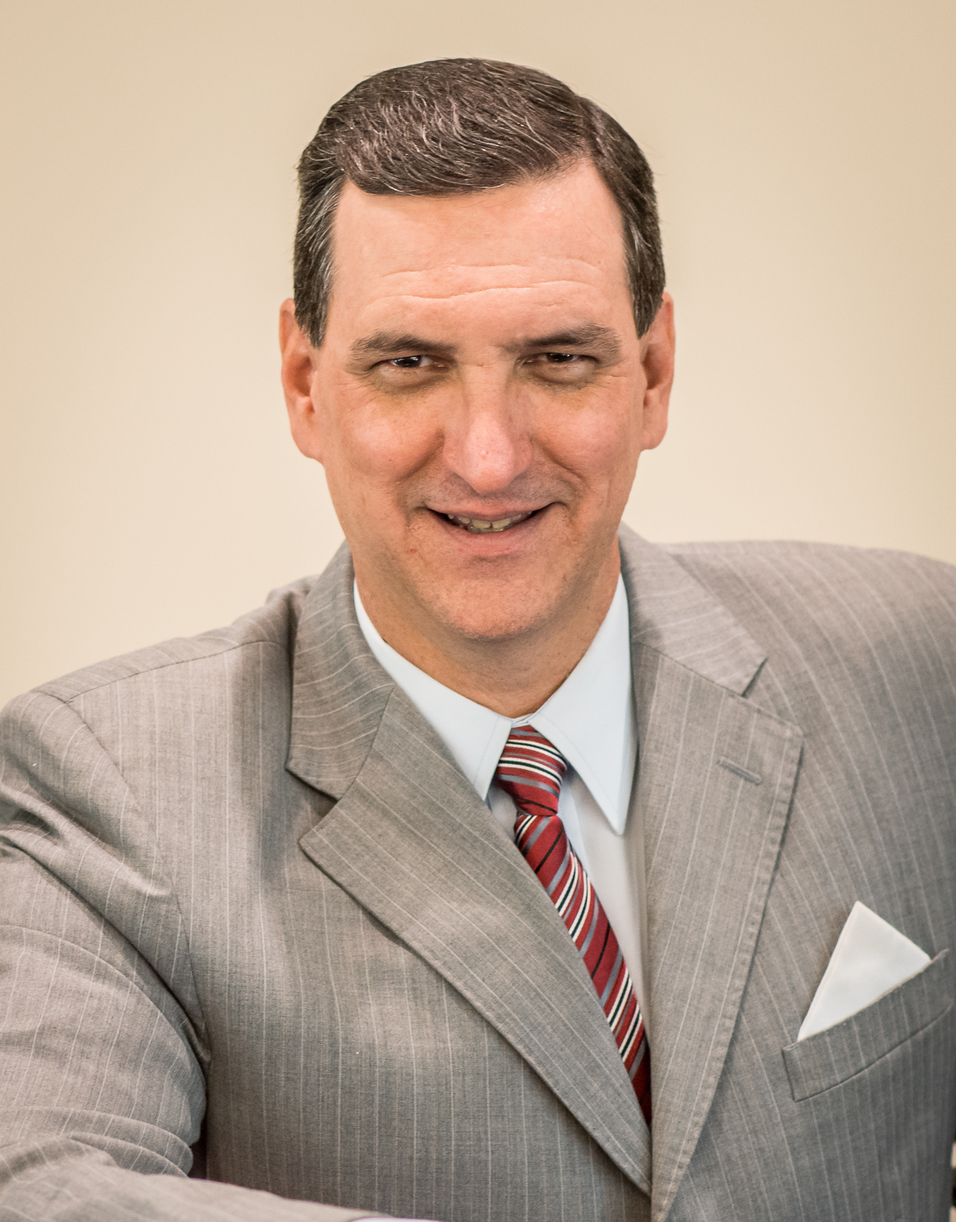
Repentance: Why It’s Necessary, and Why It’s So Hard
“Repentance” Illustrated:
Imagine I’m a bank robber. I love not only the planning, but the emotional thrill, and of course, the money and the lifestyle it provides… since I’m basically lazy!
But what if I change...
My feelings and thoughts about my practice? I decide that it’s “wrong” to take other peoples’ money, but I still love the money and I’m still lazy, so I continue the practice of robbing banks. I have not repented because although I changed my heart and mind, I did not change my practice. I’m still a bank robber. Or, what if...
The police get close to catching me, so although I still think/feel that bank robbing is the way I want to live, I stop robbing banks (at least for a while) and “lay low” to prevent my capture and incarceration. I have not repented because although I changed my habit(s), I did not change my heart and mind. I’m still a bank robber, just one on hiatus.
But if, instead of these, I decide that robbing banks is not “right,” feel sorry about what I’ve done (perhaps even returning the stolen loot), and stop robbing banks, now I’ve “repented”! I went from “bank robber” to “law abiding citizen” (thus my status/affiliation changed).
God wants the best for us, but sin is destructive here and eternally, so He wants us to repent! Rom.2:4-10

Slide 5
Repentance: Why It’s Necessary, and Why It’s So Hard
Why is “Repentance” So Hard?
We are basically creatures of habit. We feel, think, and act in habitual ways. Thus, “repentance” is hard because it requires us to change our...
Hearts- we have to feel and want differently, Jas. 4:1-4 → Eph.5:10
Minds- we have to think differently, Rom.12:2 → Eph.4:23
Actions- we have to live differently, and with a different purpose, Gal.2:20 → Eph.4:22,24
In the spiritual realm, “repentance” is not usually just changing one thing we do or don’t do, but a wholesale change of how we feel, think, and act.
Such a change is not easy, but is necessary to truly repent...
And it allows for the blessed fellowship of the best people on Earth now,
And the blessed fellowship of God in heaven both now and forever!

