Slide 2
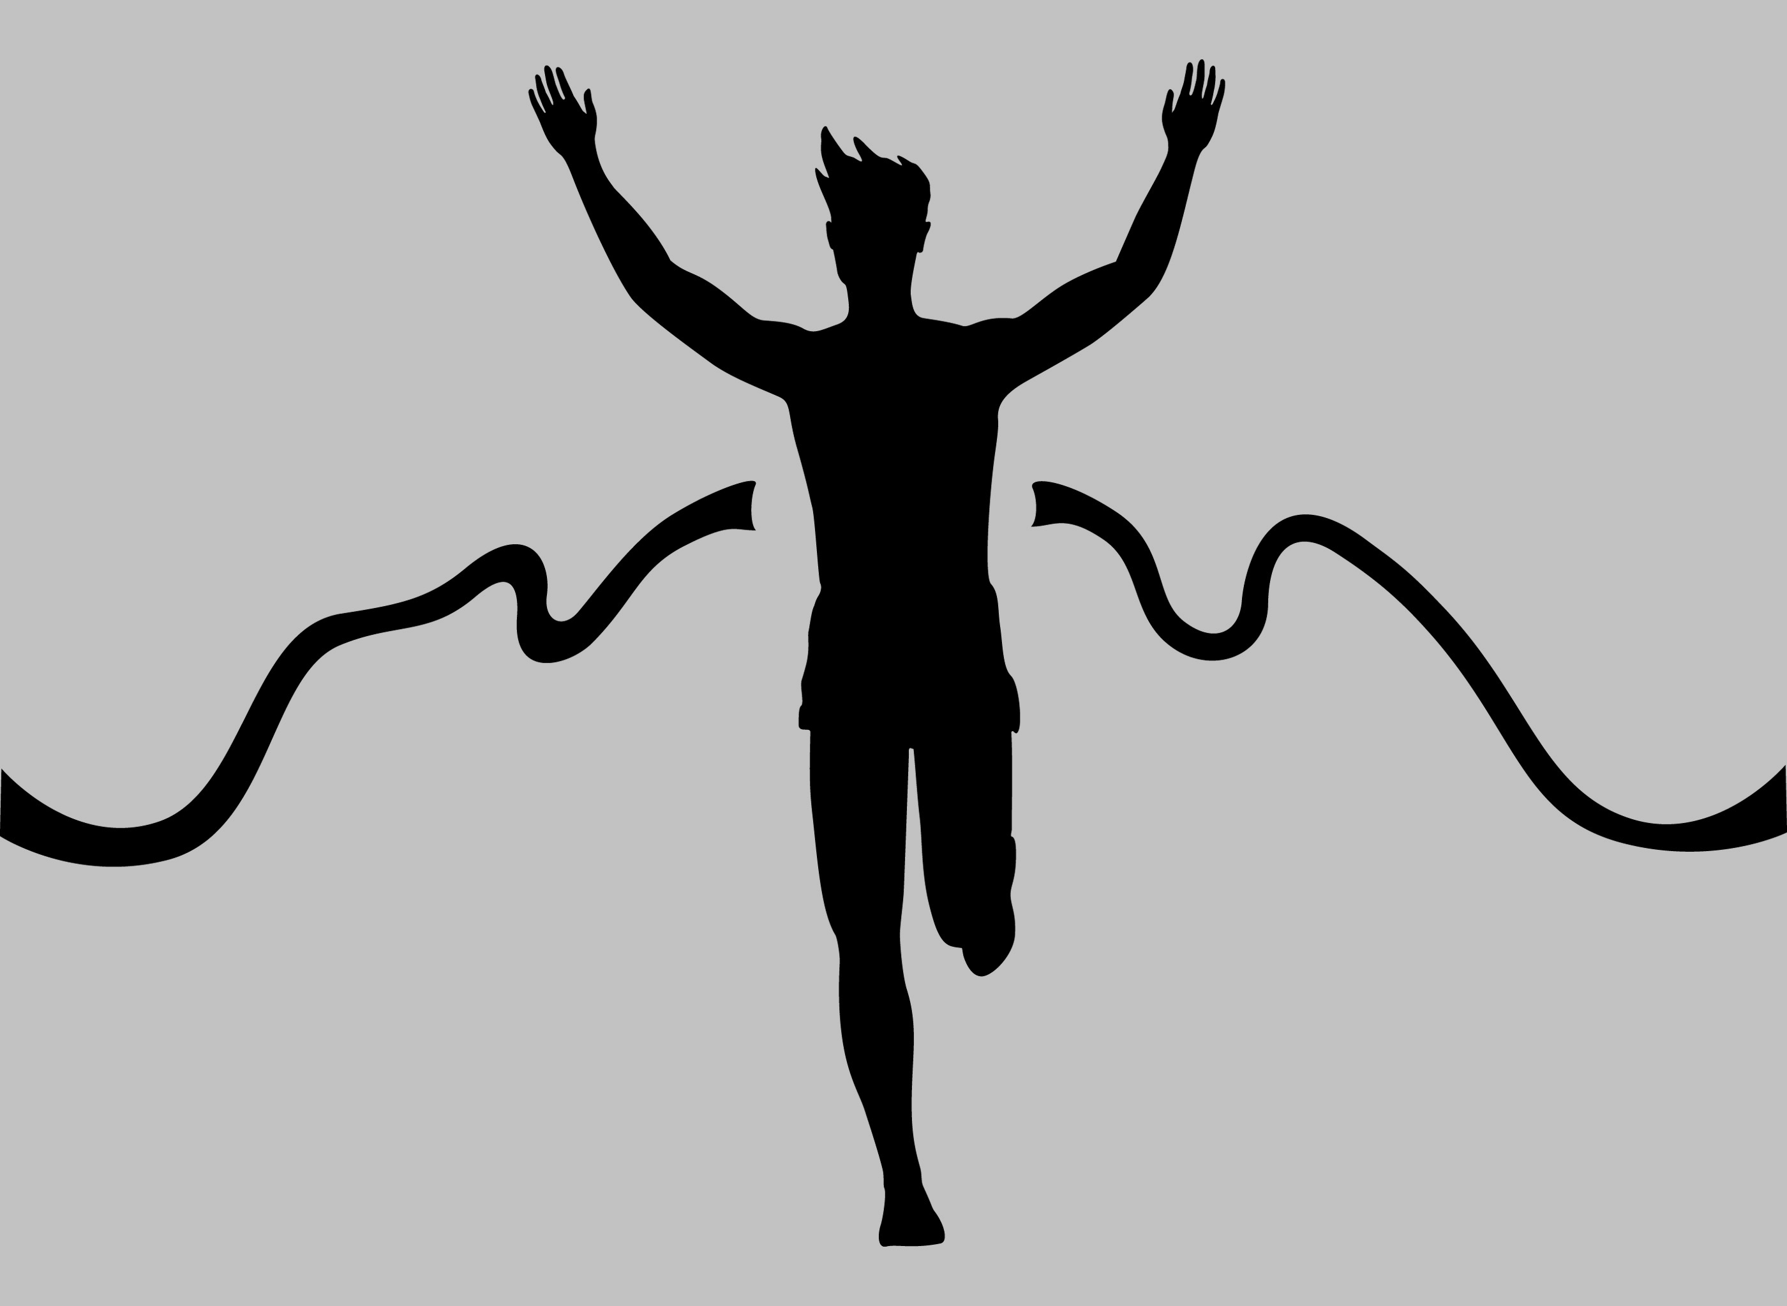
Running with Endurance
Untangle the Tangles, v.1c
Run the Race Before You, v.1d
Hebrews 12:1-2
Keys to
Successfully
Completing Your Race as a Christian:
Keep Your Focus, v.2a
For the joy ahead
Endure the present
Unconcern yourself with world’s thoughts
Sit Down, v.2b
Draw Strength from the Cloud, v.1a
Lighten the Load, v.1b
Notes:
1. Witnesses (literally, martyrs) in context, can be be positive, chp.11; or negative, 1Cor.10:1-14; can also be current and positive or negative.
2. Encumbrances (literally bulk or burden - thus weight), Rom.13:12-14.
3. Entangle (literally controlling tightly- thus restrictions), 2Tim.2:1-6.
4. Endurance- not a sprint, but not an impossible to complete marathon either; your race- not someone or anyone else’s; doesn’t mean yours isn’t similar to theirs, just not identical- same rules, route, and finish line (1Cor.9:24-27), but perhaps different obstacles, Gal.6:1-5.
5. “eyes on Jesus”- as author and perfecter (He laid out the course, wrote the rules, and finished the race perfectly). How? Understood that the joy ahead was worth far more than the suffering and shame of the present, 2Cor.4:16-18.
6. Faithful and enduring completion of the race is victory = eternal rest! Heb.4:9-11.

