Slide 2
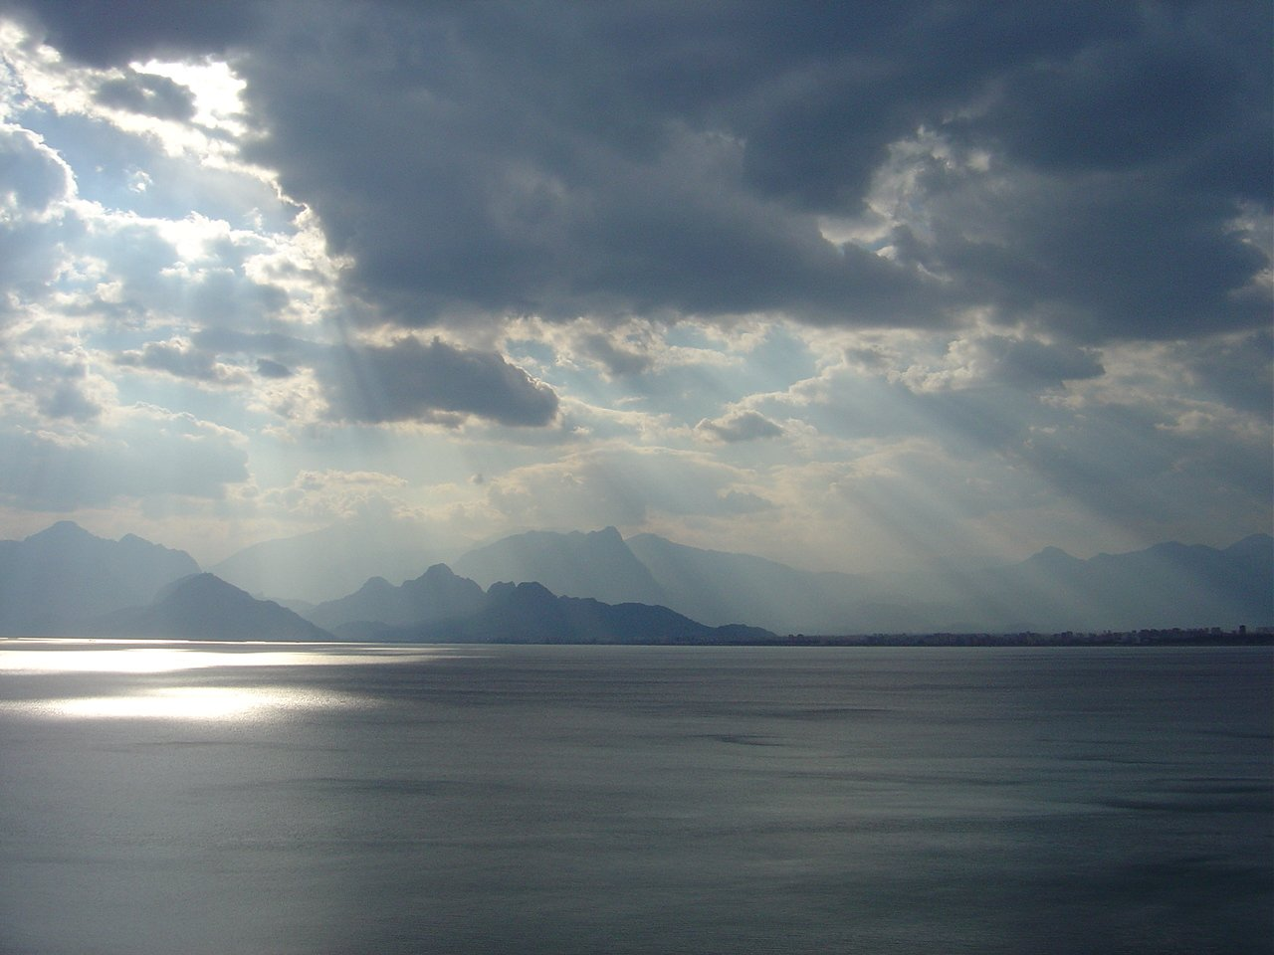
What is Your Perspective of “God”?
Is He a God of love, grace, and mercy?
Or is He a God of righteousness, justice, and wrath?
Does He accept and acknowledge everyone who admits His existence?
Or does He further discern and discriminate between the obedient and the disobedient?
Our perspective of “God” shapes our lives and determines their course, speed, and ultimately, their destination.

Slide 3
What is Your Perspective of “God”?
To answer this important question, we have but two viable options...
We can rely on the wisdom and words of men; or,
We can rely on the wisdom and words of God, 1Cor.1:18 – 2:16.
Simply put: Our perspective of God comes from either what man knows (or thinks he knows) and says about “God,” or it depends on what God knows and says about Himself.

Slide 4
What is Your Perspective of “God”?
So, how shall we come to our perspective of God?
Obviously, read fully and study carefully ALL that God has revealed about Himself!
But surely this is a lifetime commitment and beyond our scope today, so...
What verse or passage can provide substantive enlightenment to our perspective of “God”?

Slide 5
What is Your Perspective of “God”?
Let’s look at just one today, Romans 2:1-13, and then just one verse within it. First, note the context:
1:18-32 has detailed the course and destiny of those who foolishly decide “There is no God” (literally or in effect)
Then 2:1-13 has further outlined the course and destiny of those who “rely on the Law” and “boast in God,” but have a wrong perspective of Him (and His Law), thus...
Their practice of His Law’s requirements could not and did not align with their profession of faith in Him, vv.1-3,5ff.
So we again see the importance of having the correct view/perspective of “God” (and His law).

Slide 6
What is Your Perspective of “God”?
Now we’re ready for our single verse of consideration, Romans 2:4. Please note:
to “think lightly” (or “despise” in KJV) means to view with contempt, disdain, or to think little or nothing of
the word “riches” refers to fullness, abundance, or plenitude
“kindness” (or “goodness,” KJV) also includes the attributes of moral goodness and integrity
“forbearance” (“tolerance”) implies endurance
“patience” (“longsuffering”) additionally carries the ideas of constancy, perseverance, and slowness to avenge wrongs
“kindness” is repeated, though from a slightly different Greek word that more broadly conveys virtue, goodness, pleasantness, and benevolence.

Slide 7
What is Your Perspective of “God”?
These words are not hard to grasp, nor is it difficult to “see” God in these ways.
But what must also be discerned is the intent or purpose of these richly manifested attributes of God even toward those who acknowledge/believe in His existence.
They are intended to produce “repentance”!
Why?
Because the riches of God’s kindness, forbearance, patience, and even His love, can be EXHAUSTED, cf. Hos.1:6,9; 8:2; 9:15!

Slide 8
What is Your Perspective of “God”?
Such is also confirmed in our text of Rom.2:
v.5, stubborn and unrepentant hearts will receive God’s “wrath” in the day of judgment
vv.6-7, deeds will be the basis of judgment rather than intentions or misguided claims of affiliation, cf. Matt.7:21ff
vv.8-9, then God’s wrath and indignation will produce great tribulation and distress for those who disobeyed and did evil
v.10, whereas His glory, honor, and peace will be upon those who DON’T despise His kindness, but instead repent and obey Him!

Slide 9
What is Your Perspective of “God”?
If we don’t “see” this complete/whole perspective of “God” (discerned from His words), and blindly choose to accept the words of men regarding only His kindness, patience, forbearance, and love, then:
Matt.22:29, we have either been deceived or have deluded ourselves about “God”
We will suffer the same fate as those in Hosea and Romans 2 who despised God’s love and kindnesses by stubbornly refusing to repent and obey Him
Rom.11:22, “Behold then the kindness AND severity of God; to those who fell, severity, but to you, God’s kindness IF you continue in His kindness; otherwise you also will be CUT OFF.” (emp. added)

Slide 10
What is Your Perspective of “God”?
Now:
If you don’t believe God exists, please read Rom.1:18-32 and then talk to me or someone who does.
If you do believe God exists, have you based your perspective of Him and His attributes on man’s wisdom and words, or God’s wisdom and words? If it’s the former rather than the latter, please reread Rom.2:1-13 then come talk to me.
The good news is that, thus far at least, God’s kindness, forbearance, patience, and love have not yet been exhausted for us. It’s not too late for them to lead you to repentance and obedience! Will you accept them, or disregard them by continuing in stubborn rebellion and disobedience? The lesson and the choice is yours- choose wisely.

