Slide 2
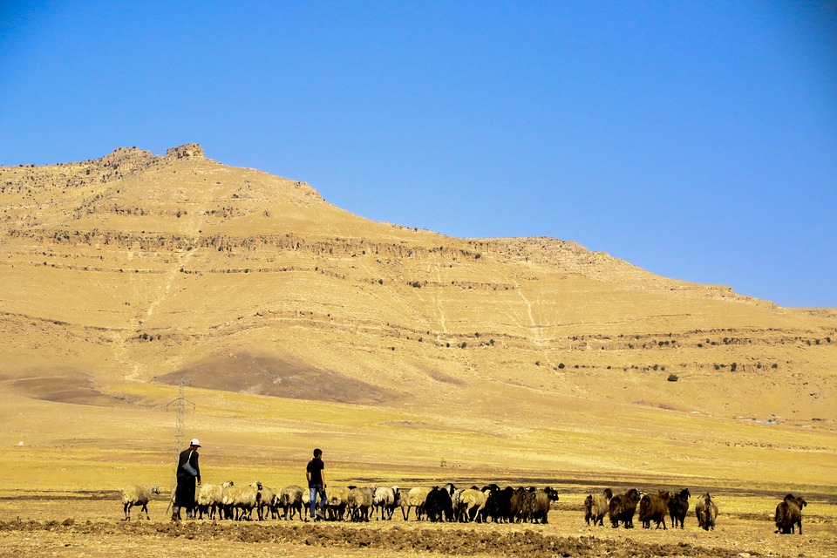
Selecting Leaders in the Lord’s Church Part 2
In Part 1, we noted:
How the Holy Spirit utilized specific words to name the office that also described its purpose, function, and duties;
The importance of understanding God’s purpose in/with the qualifications: To enable His people to identify (detect & distinguish), select (choose), and appoint (charge/commission) capable (competent) leaders (guide, provide, protect) in/for their local congregation (only those in the given locale); and,
That God’s purpose and will in these matters must also be(come) our purpose and mindset.
We also noted that the qualifications were either objective (based on fact; free of bias; observable) or subjective (existing by perception; not impartial).

Slide 3
Now, Regarding the Qualifications…
We must understand that each of them is important, and none more so than another. So, one or two of them can’t be allowed to become de facto for the rest.
In addition to being either objective or subjective overall, each of the qualifications relates to one of three areas in which the candidate should have learned and demonstrated capable leadership:
In the home with his family, 1Tim.3:2,4-5
In the congregation with his brethren, 1Tim.3:2-3,6
In the community with his neighbors, 1Tim.3:7
These areas of home, congregation, and community not only allow a man to learn leadership, they allow his brethren the opportunity to recognize his capabilities.

Slide 4
Regarding the Qualifications…
Therefore…
a) Has he learned and demonstrated good leadership in the home by being the husband of one wife? 1Tim.3:2; Titus 1:6
Did he have to wisdom to marry a good woman, or develop the leadership skills necessary to help her become one?
A man who has never married has not had the opportunity to learn leadership in this way; therefore those never married are excluded, cp. Ex.2:11 – 3:10*.
If he is scripturally divorced and remarried, was the divorce because of or in spite of his leadership?
Likewise, if he is “married” to more than one woman, he has neither learned nor demonstrated leadership in this area**. If his wife died and he married again, he is the “husband” of one wife (cf. Rom.7:1-3), but the more important question is: “Has he learned and demonstrated leadership in marriage?”
Notes:
*Though Moses was trained and “educated in all the learning of the Egyptians” by the age of 40 (Acts 7:22-23), he wasn’t deemed “ready” to lead the Israelites until he had learned “leadership” in/through being a husband and father, and had been a “shepherd” for another 40 years, Acts 7:24-34.
**He is at least a bigamist, if not a polygamist.

Slide 5
Regarding the Qualifications…
b) Has he learned and demonstrated good leadership in the home by “managing his household well” with regard to his children?
“Yes,” one child qualifies as “children,” cf. Gen.21:7; Eph.6:4; 1Tim.5:10 (biological or adopted, cf. Eph.1:5);
And “faithful” or “believing” (Titus 1:6) is translated from pistos* which can be accurately translated as such, but can also mean faithful or trustworthy to one over them, Matt.24:45; 1Cor.4:2; 1Tim.3:1,11; 4:9; 2Tim.2:11; Titus 1:9; 3:8.
Thus the question regarding “faithful” is “to whom- God, or his/her father?” Opinions surely vary, but “to his/her father” fits the context better, cf. Titus 1:6b. Wouldn’t “faithful” to God preclude the need of “not accused of dissipation or rebellion”? But it fits if we’re talking about faithfulness to their father with regard to his qualification to lead a congregation of the Lord’s people! Additionally…
Notes:
*the Holy Spirit could have easily used the word Christianos (as in Acts 11:26), but didn’t choose to do so. Ask yourself “Why not?” if that is what He meant?

Slide 6
Regarding the Qualifications…
b) Has he learned and demonstrated good leadership in the home by “managing his household well” with regard to his children? (continued)
Also think about this: Was it easier to become an elder in Ephesus than Crete (if “faithful children” refers to God rather than their father, since 1Tim.3 does not include that particular qualification)? There is no geographical or logical explanation for the omission IF such is the intended meaning.
Furthermore, note that 1Tim.3:4-5 specifies “household”- which is translated from oikos, and means house or an inhabited home. The candidate’s adult children living independently from him are no longer part of his household, and therefore not under his management or control.
“But what about Prov.22:6?” Proverbs are divine general truths, but are not absolute truths, cp.16:13 & Matt.14:1-10.

Slide 7
Regarding the Qualifications…
So, there are questions that need to be asked and answered with regard the candidate’s qualifications in this area of the home:
Has he learned and demonstrated capable leadership in the home with regard to his wife and children? 1Tim.3:5; Titus 1:6
Are the successes and/or any failures in this area because of or in spite of his leadership? cf. Hos.7:13a,15; Ezk.18:20
If you still have questions about the candidate’s qualifications regarding his leadership in the home, either ask me afterwards, or consult the additional study materials provided. Now let’s move on to the next area of consideration…

Slide 8
Regarding the Qualifications…
Has he learned and demonstrated good leadership in the congregation with/to his brethren? 1Tim.3:2-3,6*
Is he “above reproach” (unrebukeable, irreproachable)? Not that he’s never done anything wrong (Rom.3:23), but that there is nothing left uncorrected; no current or on-going basis of reproach.
Has the candidate learned and demonstrated himself to be:
temperate (sober, restrained, self-controlled),
prudent (sound of mind, sane, a clear thinker),
respectable (well ordered/arranged),
hospitable (love of and generous to strangers/people),
able to teach (capable of instructing),
not addicted to wine (given to wine, a drunkard),
not pugnacious (contentious, quarrelsome),
gentle (gracious, patient, fair, mild, and forbearing),
uncontentious (peaceable, not looking for a fight),
free from the love of money (not greedy or covetous), and
not a new convert (no neophyte, spiritually mature)?
Do you see how important each of these qualities are to the performance of his duties as a shepherd in/for the church?
Notes:
*It may be that 1Tim.3:2-3’s qualifications all belong in the home area of consideration, but we’ll deal with them relative to the congregation and brethren for now.

Slide 9
Regarding the Qualifications…
Has he learned and demonstrated good leadership in the community with/to his neighbors? 1Tim.3:7
As with all of the qualifications, but perhaps especially with the subjective ones, care must be taken in application(s). For instance,
A good and godly man will incur favor and respect from those of the world who respect goodness and right conduct, Titus 2:8; cf. 1Pet.2:12-17;
But for those of the world who despise goodness and right conduct, “nothing is pure,” Titus 1:15; cf. John 15:18-19.
Do you see how important this quality is to the performance of his duties as a shepherd in/for the church? A man with a warranted “bad reputation” in the world destroys the reputation and influence of the church, especially when appointed to leadership in it!

Slide 10
Conclusions…
The qualifications God provided are meant to allow us to identify, select, and appoint capable leaders in and for our local congregations.
Each of these qualifications is connected to his abilities to perform the duties required of elders/overseers/shepherds.
Therefore, no qualification(s), whether objective or subjective, is more important than another; all are vital.
Appointing men to this office is serious business- both for them and for us. They are agreeing to take on the responsibility to “watch over (y)our souls,” Heb.13:17b. We are agreeing to “Obey… and submit to them,” Heb.13:17a.
If we do this right, it is a “joy” for them, profitable for us, Heb.13:17c, and well-pleasing and glorifying to God!
But if we do this wrong, it will be grief for them, unprofitable for us, and displeasing and dishonoring to God.

