Slide 2
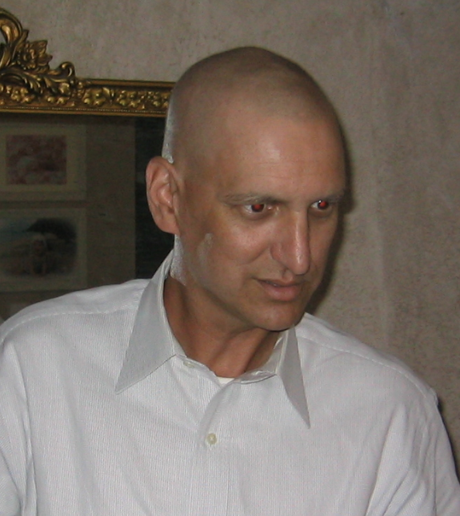
Biblical Principles and Perspectives on Cancer
Recognize this guy?
I never wanted to be the “cancer-survivor preacher.”
I would much prefer to be just a “good” preacher who teaches the Word faithfully, and helps others to know and understand it.
But we don’t always get to choose our path...
or exactly through what it takes us, Jas.1:2-8.
I like to think that “my path” has given me additional insight,
with which I hope to be able to help others.
This picture was taken ~Oct.2004, soon after completing chemotherapy for Stage 4 T-Cell Lymphoma.

Slide 3
Biblical Principles and Perspectives on Cancer
Everyone is going to die, unless the end comes first, Heb.9:27; 1Thess.4:13-18.
While some cancers have known causes, many don’t.
So never assume it is anyone’s or anything’s fault. Just deal with the reality as best you can.
If you need someone or a cause to “blame,” Satan and sin will have to do, cf. Gen.2:16-17; 3:1-7; Rom.6:23.
While we don’t get to chose how or when we die, cancer does have some advantages:
Sometimes, even when it is fatal, death is delayed.
So, it usually provides time to get your affairs in order; to say and do what needs to be said and done both physically and spiritually.
Additionally, as hard as death can be with cancer, even it beats crucifixion, cf. Acts 2:23!

Slide 4
Biblical Principles and Perspectives on Cancer
Stop asking, “Why me?” It’s the wrong question. Instead try, “Why not me?”
Do we expect cancer to be partial even though God is impartial? Rom.2:11; Matt.5:45
Are you too good for cancer?*
If you’ve committed sin, you deserve to die- we all do, cf. Rom.3:9-23; 6;23.
I’m not saying your cancer stems from your sin directly, but…
As sinners, we all deserve to die and therefore don’t really have a complaint regarding how we die. I know this is hard, but true.
But self-pity and/or blaming God isn’t going to help you do what you need to do physically or spiritually.
You have time and opportunity now to be salt and light in attitude and activity, and even in your death, if such be the case; don’t waste it with “Why me?” cf. Matt.5:13-16; Phil.1:20-24.
Notes:
*Go to a cancer hospital or wing or floor; look into the faces of the people there, and ask yourself, “Do they deserve this more than me?” Because that’s what you’re implying when you ask, “Why me?”

Slide 5
Biblical Principles and Perspectives on Cancer
Physical life- it’s length or “quality,” is not what’s really important.
“Your physical health and family are the most important things in life.”
No, they aren’t! That’s how unbelievers and those without hope think, Eph.2:12.
It’s not how long or how well you live physically that counts; but whether or not you live and die in Christ, cp. Luke 23:39-43; Rom.8:1; 6:1-14.
“But what about...
My family? Who will take care of them?” Matt.6:25-33, “seek first His kingdom and His righteousness...”
All the things I wanted to do/accomplish in life?” Matt.6:25-33, “seek first His kingdom and His righteousness...”
One of the great advantages of cancer* is that it helps us to prioritize what is really important. Your spiritual life comes first, Matt.16:26. The spiritual life of those you love comes second.**
Notes:
*Cancer is a great teacher; it teaches you: humility, empathy, trust, faith, hope, and love to name only a few of its lessons!
**Instead of using whatever time you have worrying about secondary (or even less important) things- including physical concerns for your family, concentrate on spiritual life for you and them!

Slide 6
Biblical Principles and Perspectives on Cancer
Death is not the enemy- sin is.
Death is an enemy, 1Cor.15:25-26...
But only to those unprepared for it, 1Cor.15:20-24.
For those who “die in the Lord,” death is a “blessed” event, Rev.14:13a.
Do you really believe that?
If so:
Then it changes the way you live, Rev.14:13c; 2Cor.10:3-7
And it changes how you die (view and approach to death), Rev.14:13b; Phil.1:21.
We don’t really know how to live, unless/until we know how to die. And conversely, dying right is all about living right.
This changes our perspective of living and dying, 1Thess.4:13-18.

Slide 7
Biblical Principles and Perspectives on Cancer
Before we conclude, please allow some purely practical advice:
Even if you survive cancer, you’ll never really be “cancer-free”- it will always be in the back of your mind.
You can learn to live with that, or let worry consume and rob you of “life” and its opportunities.
And when dealing with doctors & treatments:
Don’t ask questions you don’t really want the answers to- they want you to have a positive attitude, but will answer questions you ask. So don’t ask what you don’t really want to know.
It’s OK, to say, “Enough.” As a Christian, your perspective of life and death- as well as what each means, is different than theirs...
You’re in charge of your treatment, or lack thereof.

Slide 8
Biblical Principles and Perspectives on Cancer
Conclusions:
Regardless of your health or lack thereof, you’re not really ready to die unless you’re ready to die today- are you? If not, why not?
If you are ready to die today, then TRUST GOD REGARDING EVERYTHING, 1Pet.4:19.
Cancer can help teach (if we are willing to learn) the importance of:
Patience, Jas.1:2-8
Trust, Matt.6:33-34
Faith, 1Pet.1:21
Hope, 1Cor.15:42-58
Love, 1John 4:4-19
In Christ, you are so much more than a diagnosis…
so don’t let “cancer” define or control you!

