Slide 2
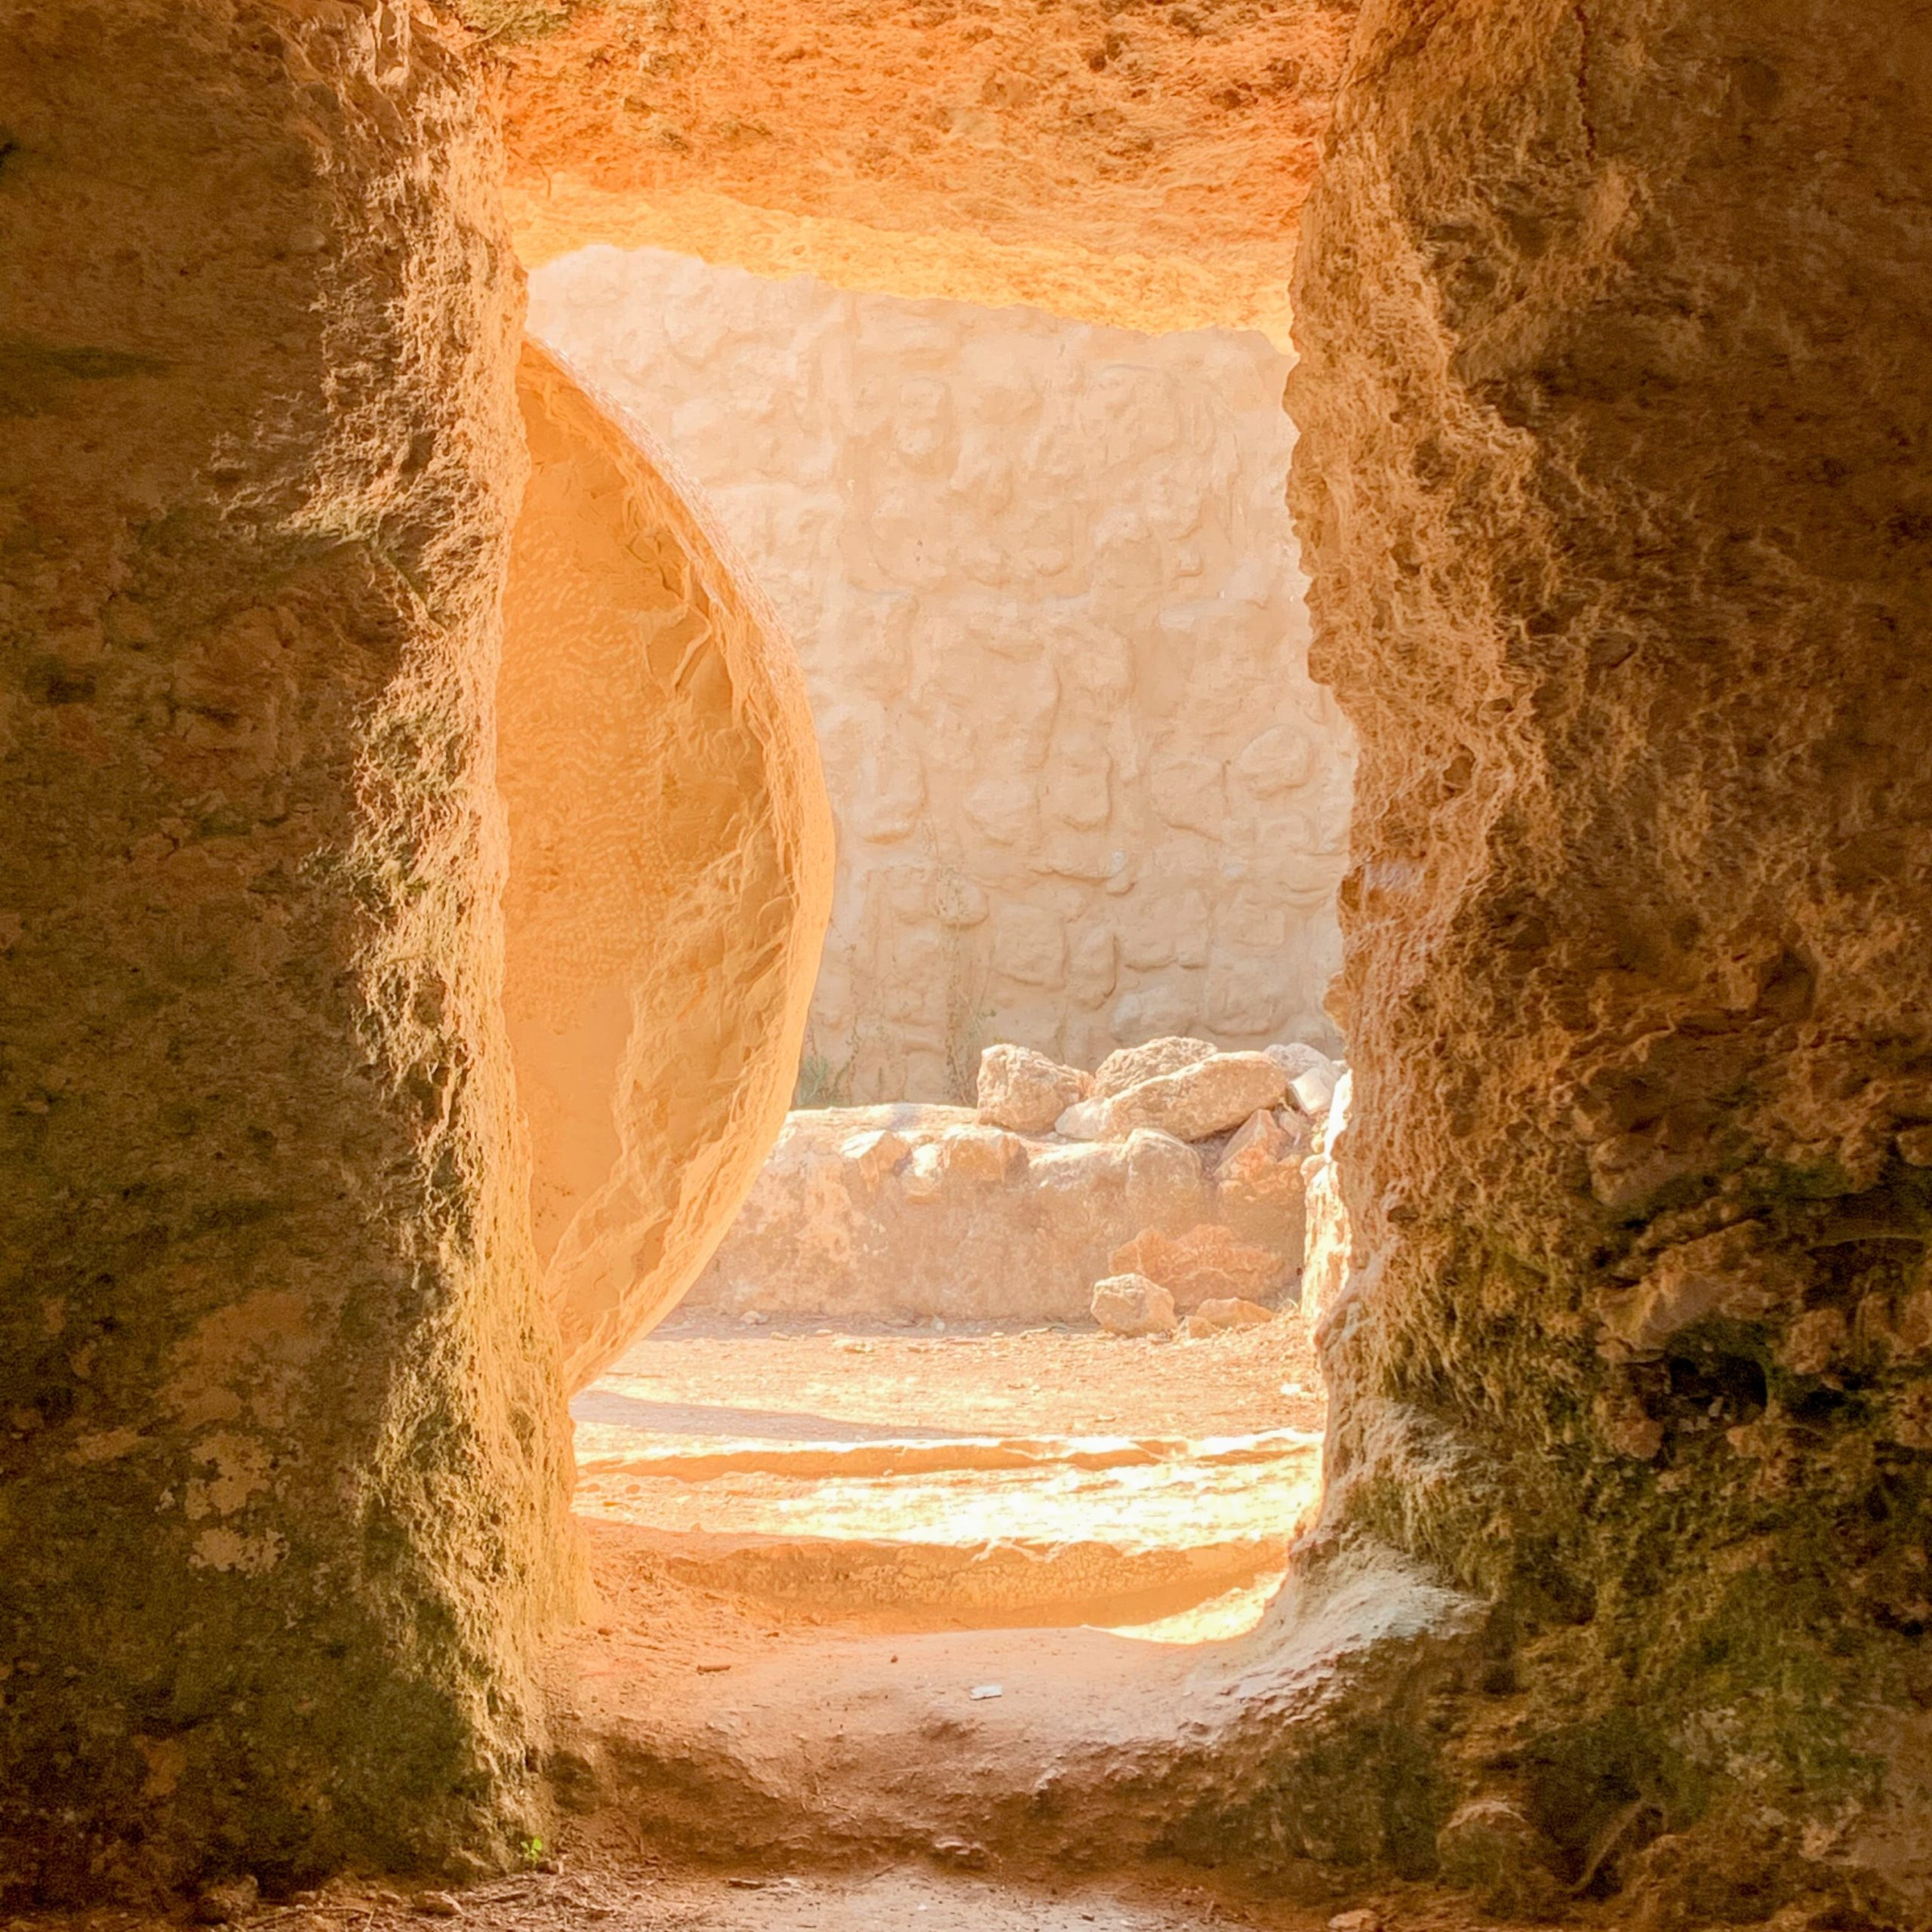
The Resurrection
Luke 24:1-11
Its Importance:
Proved Jesus was the Son of God, Rom.1:4
(because)
He predicted it, John 2:18-22
Without it, His life and death would be meaningless, 1Cor.15:17

Slide 3
The Resurrection
Its Benefits:
Unless we believe, NONE, 1Cor.15:12-19
(but)
If we believe, then we know ALL will be resurrected, 1Cor.15:20-28
Are only for those who die and live with Him spiritually, Rom.6:1-11

Slide 4
The Resurrection
Conclusion, Phil.3:7-11
To receive the benefits of Jesus’ resurrection, we must:
Be willing to count all things as “loss,” vv.7-8
Be “found in Him,” v.9
And “know Him and the power of His resurrection and the fellowship of His suffering, being conformed to His death,” v.10
In order to “attain” our own “resurrection from among the dead,” v.11

