Slide 2
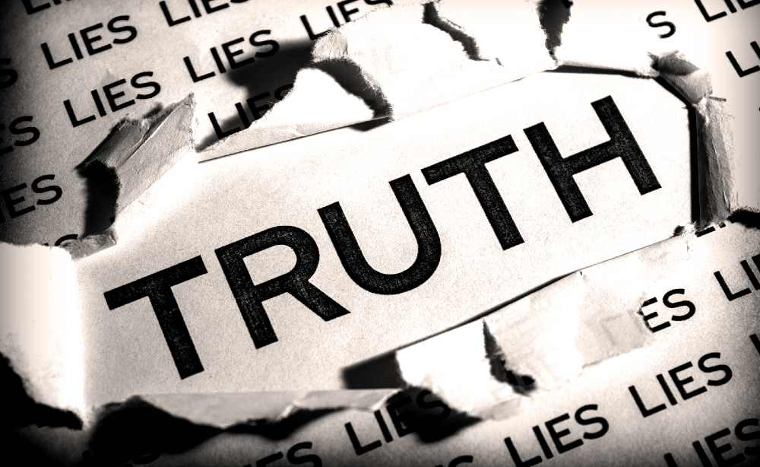
“Honest and Sincere” (Beliefs, Practices, and Worship) versus

Slide 3
“Honest and Sincere” vs. Truth
Let’s review last week’s key points relative to “Truth”...
“Truth” is not relative; it is evidential and empirical
“Truth” is neither personal nor subjective; it is universal and objective
“Truth” does not have ‘alternative truths;’ the ‘alternative’ for “truth” is falsehood (and/or lies)
“Truth” is not equal to nor determined by feelings; Truth-seekers accept truth based on evidence regardless of how they feel about it
“Truth” is not determined by belief(s) or perception(s); our beliefs and perceptions must stem from “truth,” not the other way around, else we are misguided fools.

Slide 4
“Honest and Sincere” vs. Truth
Understanding these principals, let’s consider the common religious sentiment that is often stated as,
“It doesn’t really matter what you believe and practice (or how you worship) as long as you’re honest and sincere.”
How does such a conviction/statement correlate to the nature of “truth”?
Simply put: It doesn’t.
Neither honesty nor sincerity on the part of the individual establishes “truth” since it is not relative to them but evidential and empirical. Apollos was both honest and sincere but also “wrong” because he lacked critical “truth,” Acts 18:24-28.
An “honest” person can still believe a lie and act accordingly. Saul of Tarsus believed the lie that Jesus was an imposter, and thus persecuted those who knew the truth, cf. Acts 7:51 – 8:3. Yet he “lived … with a perfectly good conscience,” Acts 23:1. Did such make his belief and practice “right” (based on truth)? Of course not, and he knew it, cf. Gal.1:13-17; 1Tim.1:12-17.

Slide 5
“Honest and Sincere” vs. Truth
Understanding these principals, let’s consider the common religious sentiment that is often stated as,
“It doesn’t really matter what you believe and practice (or how you worship) as long as you’re honest and sincere.”
What does such a conviction/statement falsely assume about God?
That He doesn’t really care about “truth.” But He obviously does, Rom.3:3-4; Titus 1:2; John 17:17!
That He is willing to allow us to determine our own “truth.” He isn’t, Isa.55:8-9; Jer.10:23; John 3:21; 8:31-32 → Phil.3:18-19.

Slide 6
“Honest and Sincere” vs. Truth
Understanding these principals, let’s consider the common religious sentiment that is often stated as
“It doesn’t really matter what you believe and practice (or how you worship) as long as you’re honest and sincere.”
Do biblical examples to support or deny this conviction/statement?
Relative to Noah’s belief and practice? Heb.11:7; Gen.6:8-9,22; he listened to and believed God, and thus obeyed; he didn’t attempt to do things his own way!
Relative to Saul/Paul’s salvation? Though Paul saw and spoke to Jesus (and had a miraculous experience- blinded, then eventually healed), and spent three days fasting and praying, he still had to obey, Acts 9:6-11; 22:16; he was not “saved” in his own way (how he wanted).
Relative to Cain and Abel’s worship? Heb.11:4; Rom.10:17; Abel listened to and obeyed God, but Cain didn’t- which one’s “worship” was accepted?
“But what about Moses’ failure to obey? Didn’t God provide the water despite Moses’ disobedience in Num.20:7-11?” Yes, the Lord still provided Israel with water despite Moses’ disobedience, but note v.12 where Moses himself (the disobedient one in this case) was prevented from entering the Promised Land!

Slide 7
“Honest and Sincere” vs. Truth
Now, does
“It doesn’t really matter what you believe and practice (or how you worship) as long as you’re honest and sincere”
make any sense with regard to “truth” generally? Is that how “truth” works? Nope.
Is it in keeping with the revealed nature of God? Not at all.
Are there any direct statements or biblical examples to verify the “truthfulness” of this statement? Not a one.
Then why do people believe and espouse such nonsense? They either:
Have fallen prey to the lies of Satan, John 8:43-47; or,
Are just plain spiritually lazy, and think adopting such a conviction somehow relieves them of the responsibility to learn and obey the truth. It doesn’t, cf. 2Thess.1:8-9.
Obviously, there is a better, “truthful,” way, 2Thess.2:13-14; 1Thess.2:13. Which will YOU choose?

