Slide 2
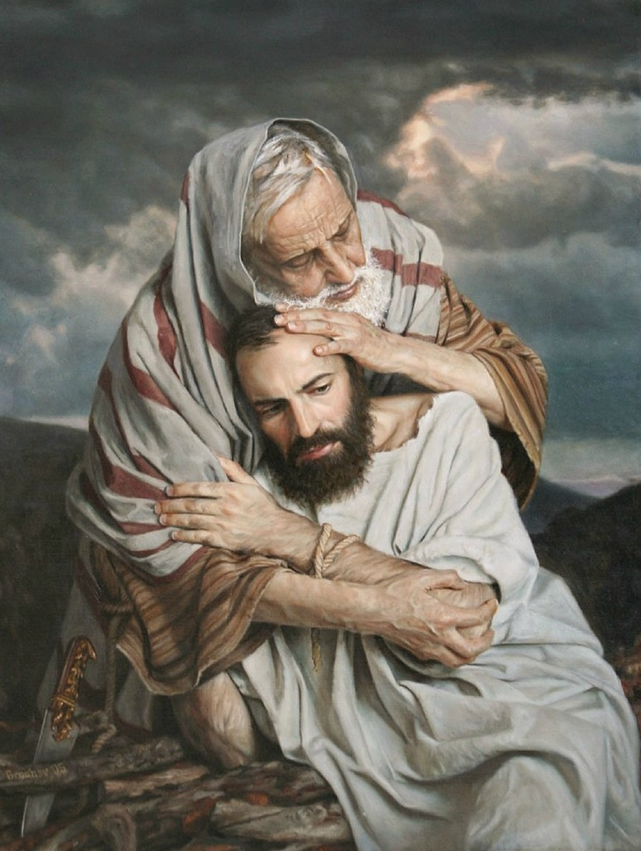
Believing and Trusting God: Developing Abrahamic Faith
There is a huge difference between believing in God and believing God...
Believing in God merely acknowledges His existence, while believing God explicitly trusts Him and His Words.
Which of these best characterizes You? (cf. Mark 9:24)
Which of these characterized Abraham? Rom.4:3
But how/when did Abraham come to fully believe and trust God?

Slide 3
Believing and Trusting God: Developing Abrahamic Faith
Rom.4:18-22 associates Abraham’s unwavering and strong faith with the conception of Isaac.
But what was his faith like before that time?
Was his faith born fully mature?
Or did it have to grow and endure over time and with experience (trials, tests, and temptations both failed and overcome) to become unwavering and strong? Let’s see...

Slide 4
Believing and Trusting God: Developing Abrahamic Faith
Consider God’s first call to Abraham, which was not made to Him in Haran (Gen.12:1-4), but in Mesopotamia, or Ur, Acts 7:2 (cf. Gen.15:7; Neh.9:7):
Did he then believe and trust God enough to fully obey?
“Well, he left Ur, didn’t he?”
Yes, but, what did God actually command him to do?

Slide 5
Believing and Trusting God: Developing Abrahamic Faith
Consider God’s first call to Abraham, which was not made to Him in Haran (Gen.12:1-4), but in Mesopotamia, or Ur, Acts 7:2 (cf. Gen.15:7; Neh.9:7):
Consider Gen.12:1-3 carefully, “from your relatives… and from your father’s house” (cf. Josh.24:2)
Now look at Gen.11:27-31; and 12:4-5.
His faith was not yet mature enough to fully obey.

Slide 6
Believing and Trusting God: Developing Abrahamic Faith
What about after he got to Canaan? Was his faith then unwavering? Ponder also:
Gen.12:10-20, did he fully trust God’s promise to make him a great nation when he deceived Pharaoh?
Did he fully trust God’s promise in his and Sarai’s schemes to produce a heir in Gen.15:1-5 and 16:1-16?
Did he believe God in Gen.17:4-8? Cf. vv.17-18 to see that he did not.
His faith was not yet mature or strong, let alone unwavering!

Slide 7
Believing and Trusting God: Developing Abrahamic Faith
So what’s the point? That Rom.4:3 and Heb.11:8-12 got it wrong?
Not at all! But rather that Abraham’s strong and unwavering faith took some time and experience(s), including several failures of faith, to grow and mature...
Isaac was born 25 years after God’s promise, cf. Gen.12:4 and 21:5;
And Isaac was no toddler when God “tested Abraham” in Gen.22:1-2,6-7!
But NOW, Abraham’s faith was mature, strong, and unwavering, Gen.22:3-5, 8-12; and Abraham NOW obeyed God fully, vv.16-18!

Slide 8
Believing and Trusting God: Developing Abrahamic Faith
Take-Home Applications:
Faith strong and mature enough to fully obey in testing circumstances takes time, experience, and endurance to develop, so...
Don’t give up, Heb.10:36
Keep listening to God and doing your best, Mark 9:24; Rom.10:17
And learn and grow, even and perhaps especially from “the testing of your faith,” Jas.1:2-12!
“Yes, you can”- Abraham did!

