Slide 2
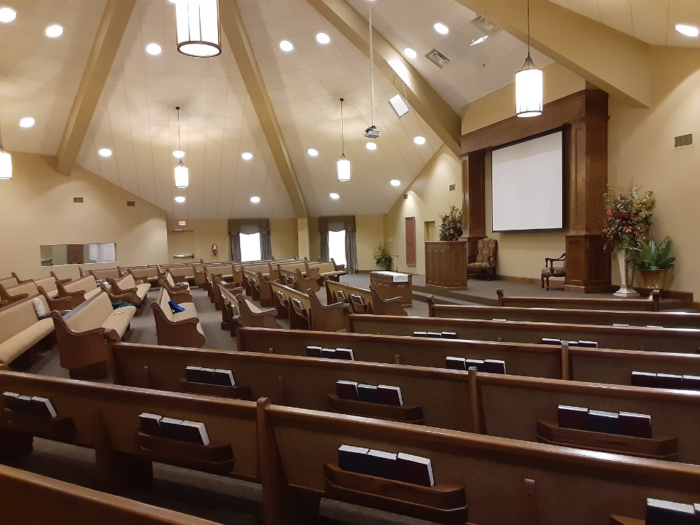
Sowing Seed and Gathering Fruit for Eternal Life John 4:35-38
Lately we’ve examined a few common precepts of men in comparison to the word of God, cf. Matt.15:8-9,6.
But we must also be proactive in proclaiming the gospel for it “is the power of God for salvation,” Rom.1:16.
To that end, let’s see if we can discern a few things that should help our efforts at sowing the seed of the kingdom that we might bear much fruit to the harvest of eternal life, John 15:8; 4:36.

Slide 3
Start with (and keep) the right attitude. Remember why you’re doing what you’re doing.
Use your love and care for souls to be kind and gracious.
We must love/care for souls to be effective seed-sowers, 1Tim.2:1-6 (What will you give in exchange for someone else’s soul? cp.Matt.16:26)
Simple kindness, patience, and gentleness are a must, 2Tim.2:24-26 (Remember: It’s easy to tell someone they’re wrong if you don’t care whether or not they become right, Luke 6:31)
Things that are plain, simple, and obvious to you now weren’t always that way; patience is a virtue, always, cf. Jas.5:7

Slide 4
Be careful with your language.
Use “the Bible says...”
Avoid “I believe/think/feel...” and “our church/preacher teaches/says”
None of these things matter. What “God says” DOES, Rom.4:3a; Gal.4:30a
If the person with whom you’re speaking says “I believe/think/feel…” just respond (kindly & graciously) with “But the Bible says…” then let in sink in for a minute or two, and ask if what anyone thinks/believes/feels or teaches or practices is more important than what God says? John 12:48-50

Slide 5
Back up to move forward.
Find common ground; back up as far as necessary to do so.
Religious practice/worship not common ground? Back up to salvation’s requirements, Acts 17:16-21,22-31
Salvation’s requirements not common ground? Back up to the Bible is God’s inspired/authoritative word, Acts 19:1-7
Inspired/Authoritative Bible not common ground? Back up to belief in God, Christ, Holy Spirit, John 14:1 (marginal, “you believe in God…”
Belief in God not common ground? Back up to Evidences vs. Evolution, Heb.3:4
Be willing to back up until common ground can be found, then move forward with “What does the Bible say about…?”

Slide 6
Ears are as important as tongues.
Ask good questions, then listen perceptively before proceeding.
Jesus understood the importance of asking and listening, Matt.16:13-15
From Acts 8:30-38, this …
puts you in charge of the discussion’s direction
allows you discover where they are spiritually
enables the dialogue to proceed in a productive way
to the appropriate goal
Use questions to lead them to the right/biblical answers!

Slide 7
Context is critical.
Use context to reveal the true meaning of their verse.
Jumping from their verse to a different book, chapter, and verse (in their mind) just pits one passage against another passage. One verse does not “trump” another one.
Instead, stay local and be sure their verse agrees with its own context, cf. John 3:16 → vv.3,5 → v.36.
Emphasize the harmony of the Scriptures; that no one verse’s correct interpretation disagrees with its own context, or what else the NT says on the same subject, 1Cor.14:33,37.

Slide 8
and Never, Never, Never...
Allow private interpretations.
The idea of “That’s just your interpretation” or “We just understand that differently” is ubiquitous but repugnant to Scripture, 2Pet.1:19-21 ...
And Logic. We do NOT “understand” anything differently; you may understand and I may misunderstand, or vice versa, but we do NOT “understand” truth “differently” for a simple reason: “Truth” does not say two different things to two different people, Rom.3:3-4; 1Cor.14:33
“Truth,” correctly understood, is “true” for everyone, Rom.2:4-13

Slide 9
Conclusions
The souls of most people we encounter on a daily basis are currently lost, Matt.7:13-14.
They are likely to become eternally lost unless someone (you or me) cares enough to be discontent just eating the seed ourselves and starts sowing it, Matt.13:3ff. No sowing = no harvest.
We need to do a better job of sowing and reaping for the harvest of eternal life, John 4:36. Hopefully, this lesson helps!

