Slide 2
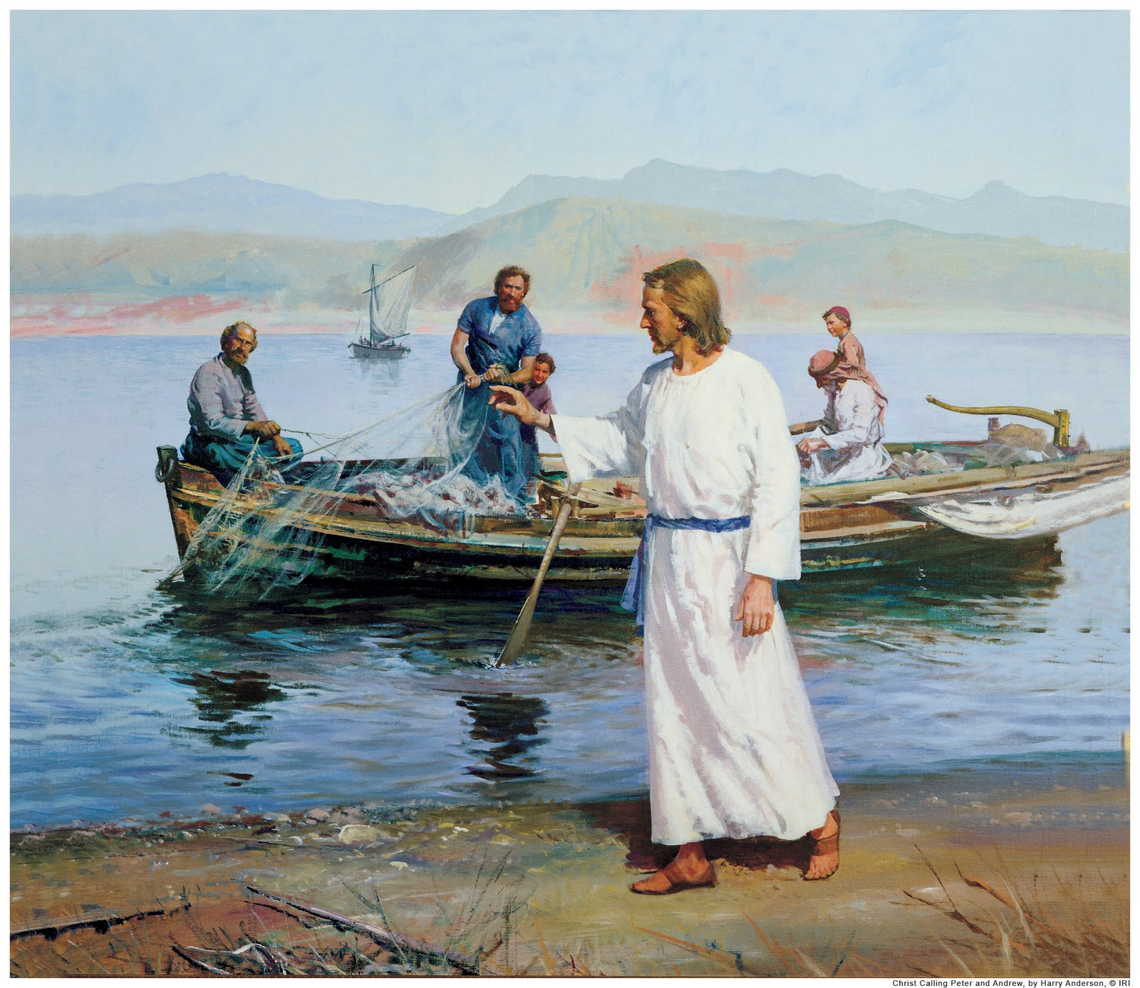
Becoming “Fishers of Men”
Lesson 1
Mark 1:14-20

Slide 3
Becoming “Fishers of Men”
One clear lesson that must be learned from the parables (an earthly/physical story with a heavenly/spiritual meaning), and applied to idioms such as “fishers of men,” is that:
To understand the heavenly/spiritual application, you must first be familiar with and understand the earthly/physical illustration.
So it is with fishing for men. To fully comprehend, appreciate, and apply the principles, you must first understand the figure from which they are drawn.
Thus, there are principles of fishing that are essential to our preparation to be “fishers of men”…

Slide 4
Becoming “Fishers of Men”
Hence, there are practical lessons to be drawn from fishing that should be understood and applied:
1. Be Prepared.
Have a plan, 1Pet.3:15; Prov.15:28; Heb.10:24.
Maintain your tackle,
Invest in a good Bible, Psalm 19:7-10; Matt.13:45-46;
Create your own topical index, Prov.25:11; 1Pet.3:15; Col.4:6;
Keep your Bible handy- you never know when the bite might occur, Acts 8:26ff;
Buy another one(s) just like it.
Most fisherman can “catch” fish when they’re jumping in the boat- but good fisherman are prepared by having their boat in the water and their tackle ready!

Slide 5
Becoming “Fishers of Men”
Hence, there are practical lessons to be drawn from fishing that should be understood and applied:
2. Watch the “water.”
Signs are important to success! Therefore, watch:
The “school of fish” collectively for opportunities, Ezk.3:4; Matt.9:10ff; Acts 17:17ff (go where the fish are, more on this later);
But pay particular attention to individual separatist behavior, Luke 19:1-5ff; Acts 8:28; 10:1-2.
Woman to husband: “I don’t know why you keep going fishing- you never catch anything.”
Husband’s response: “Well, there’s one thing for sure, I won’t catch any by staying here at the house!”

Slide 6
Becoming “Fishers of Men”
Hence, there are practical lessons to be drawn from fishing that should be understood and applied:
3. Don’t spend too much time in unproductive waters.
If the “fish” are not “biting,” you have three choices:
Move on, Matt.10:14; 7:6;
Change the variables, Col.4:6;
Continue to waste time and energy on uninterested “fish,” and squander opportunities for “fish” that are hungry, or can be enticed to be so, John 4:35.
When it comes to fishing for men,
there truly are “other fish in the sea!”

Slide 7
Becoming “Fishers of Men”
Hence, there are practical lessons to be drawn from fishing that should be understood and applied:
4. Go where the “fish” can be found.
True, we have “responsibilities at home” which must be met through continued encouragement and edification, Heb.12:12-17;
But, “the world” (of fish) which needs catching doesn’t always come to our home port/marina, Luke 14:15-24!
The monastery approach may increase holiness, but won’t work when fishing for men, Eph.5:7-17.
“Church house evangelism” is somewhat akin to fishing in the bathtub-
it may be clean, but you don’t catch much!

Slide 8
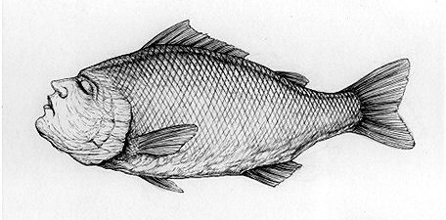
Becoming “Fishers of Men”
Conclusions:
Be prepared- have a plan, and maintain your tackle;
Watch the water for school activity and individual separatist behavior;
Don’t spend too much time in unproductive waters; and
Go where the “fish” can be found.
To be productive “fishers of men,” you have to think and act like “fishermen!”
Now, prepare your tackle and start fishing!
You can’t catch “fish” with the boat in port, or the tackle at home.
As my old fishing buddy used to always tell me:
“A man that is too busy to fish,
is just too busy!”

