Slide 2
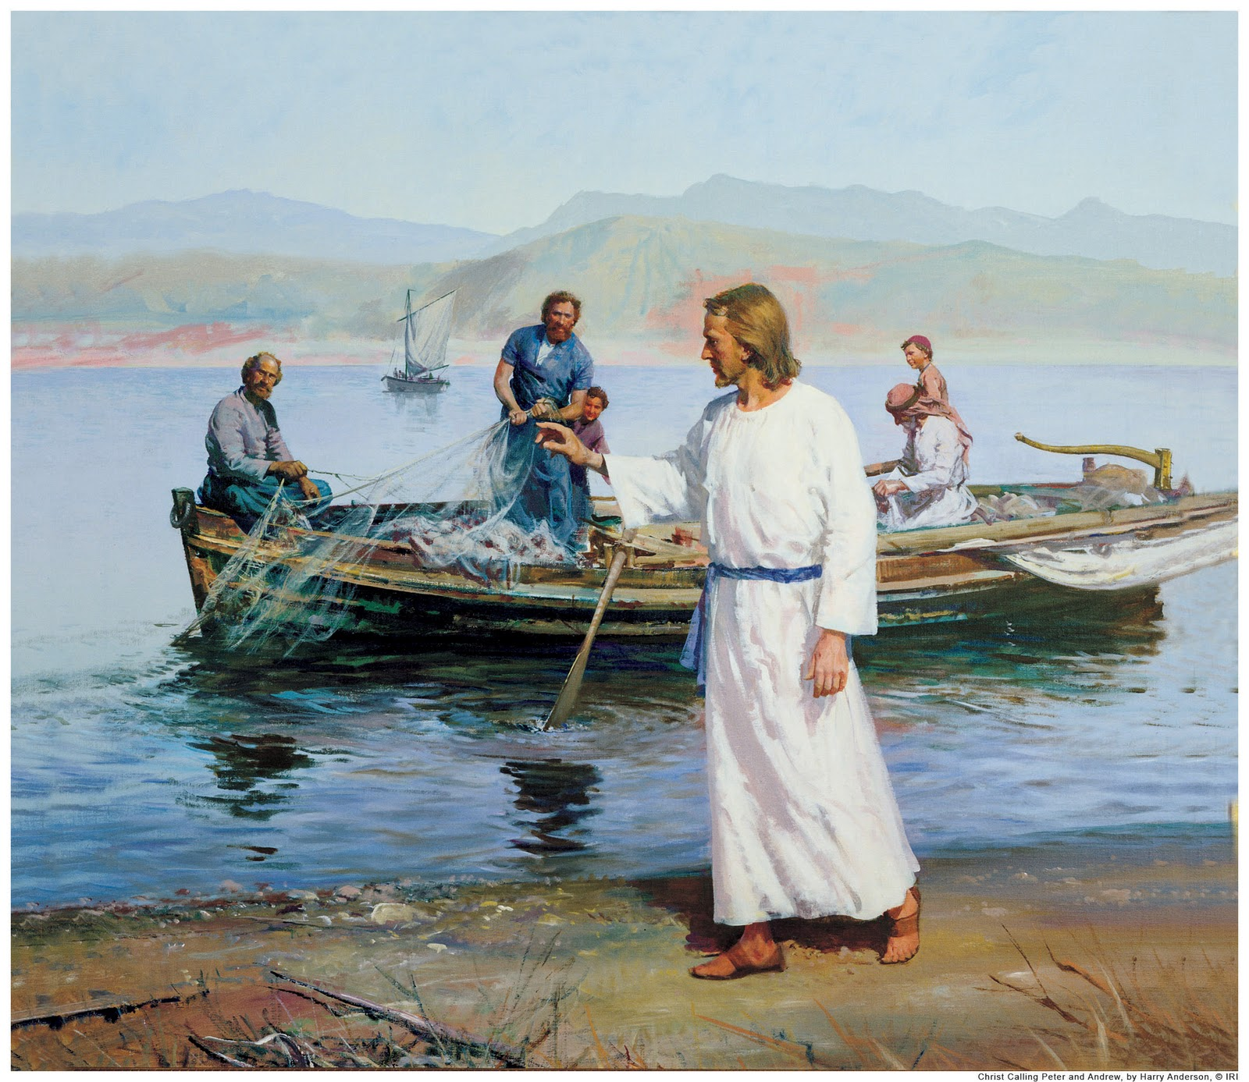
Becoming “Fishers of Men”
Lesson 3
2Corinthians 10:3-5

Slide 3
Becoming Fishers of Men: A Quick Review
Lesson 1- Comparisons between fishing for fish and fishing for men: Be Prepared; Watch the Water; Don’t Spend Too Much Time in Unproductive Waters; and, Go Where the Fish Are
Lesson 2- Personal Work: the NT Emphasis; a Line of Workers; and, Six Reasons We Should be Personal Workers
And now, Lesson 3- Essential Qualities of an Effective Personal Worker (Spiritual Fisherman)

Slide 4
Becoming Fishers of Men: 2Cor.10:3-5, The Nature of Spiritual Fishing
Winning souls for Christ (productive fishing) involves physical effort, but is more of a mental and moral process where we attempt to:
Arouse the realization of a lost condition, Rom.7:7b
Manifest God’s plan for his spiritual predicament, Eph.1:3-14; and,
Encourage and elicit a desire to obey, Eph.4 – 6
If we are good fishermen and they are willing, this results in: a Mental Change of views and perspective; an Emotional Change of heart and desire(s); and, a Physical Change of dedication, direction, and destiny.

Slide 5
Becoming Fishers of Men: 2Cor.10:3-5, The Nature of Spiritual Fishing
To accomplish these objectives, a few things have to take place:
Spiritual Need must be realized, Rom.3:23; 6:23
Trust in the Scriptures must be established, John 17:17; 12:48; Eph.1:13a; 3:3-5; and,
Confidence in you as a competent guide to the Scriptures also helps, Acts 8:30-35.

Slide 6
Becoming Fishers of Men: 1Thessalonians 1:8 - 2:12
Therefore, you need to prepare yourself to be:
Knowledgeable, 1Thess.1:8
Committed and Patient, 1Thess.1:9-10
Opposed and Mistreated, 1Thess.2:1-2
Sincere, 1Thess.2:3
Earnest, 1Thess.2:4
Frank/straightforward, 1Thess.2:5-6 (cf. Gal.2:11ff)
Kind, caring, gentle, and sacrificial, 1Thess.2:7-8
Diligent, 1Thess.2:9
Exemplary, 1Thess.2:10
Invested, 1Thess.2:11-12

Slide 7
Becoming a Fisher of Men...
Isn’t a pastime or hobby to be engaged in for personal pleasure during our free time, Phil.1:15-17.
It is a vocation into which we grow as we mature in Christ, Col.1:3-6, 9-12.
If you can’t fish yourself (Jas.3:1ff)...
You can at least cut bait by:
Being an example of Christianity, 1Tim.4:12; Titus 2:6-7
Inviting others to worship and bible study with you here, Eph.5:15-17
Setting up a bible study in your home for your family, friends, and associates that a capable fisher of men can teach, John 1:43-46

Slide 8
Fishing for Men...
Is this most important thing one can do for his fellowman.
It isn’t easy, but it is essential.
We’ll never become fishers of men unless we:
Properly prepare and equip ourselves in/with the Word;
Have the proper love and affection for souls; and,
Cast our net/line into the water!
You can do this; the question is: will you?

