Slide 2
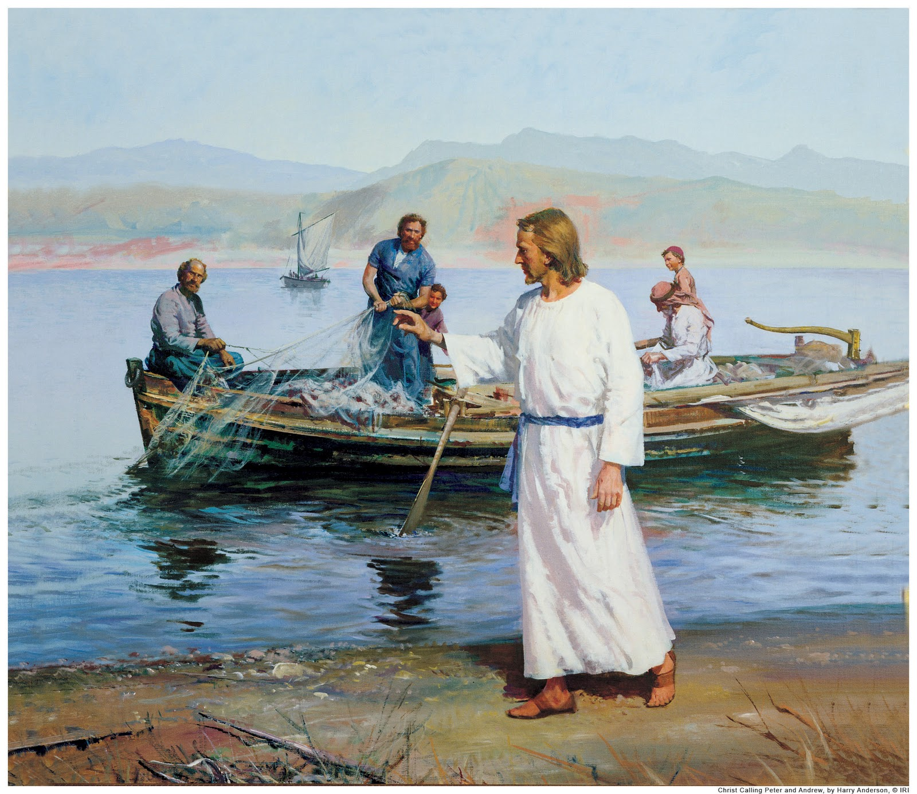
Becoming “Fishers of Men”
Lesson 5
Acts 8:26-40
Where we’ve already been:
Lesson 1, Fishing for Fish and Fishing for Men
Lesson 2, Six Reasons We Should be Personal Workers
Lesson 3, Essential Qualities of an Effective Personal Worker
Lesson 4, What You Need to Know (to be an Effective Personal Worker)*
And now (finally!), where we’re going today...
Lesson 5, Personal Work Strategies: What You Need to Do and Say (to be and Effective Personal Worker)
Notes:
*Two biggest fears that inhibit us from doing Personal Work: 1) “I’m afraid I don’t know enough”- which we addressed in the previous lesson; and, 2) “I’m afraid I don’t know where to begin or how to proceed”- which is today’s lesson.

Slide 3
Personal Work Strategies
This lesson does not stem from my expertise (or lack thereof), but from the inspired wisdom of the Holy Spirit by providing a how to “case study” in Acts 8:26-40.
First, some context...
Philip was one of the 7 chosen in Acts 6:1-6*
Next, the story follows 2 of these 7 men...
Stephen in Acts 6:8 -7:60; and,
Philip in Acts 8:5ff.
But Acts 8:1-4 is important to the story also.
Finally, Acts 8:5-25 details Philip’s efforts in Samaria and the results. Which brings us to our primary text of Acts 8:26-40.
Notes:
*note the qualifications in v.3, especially “full of the Spirit” prior to v.6 (and 8:18)- meaning one can be full of the Spirit in non-miraculous ways.

Slide 4
Personal Work Strategies: What can we learn about what to do and say from the “case study” in Acts 8:26-40?
v.29, Listen to and follow the Holy Spirit.
Not “go here and talk to her/him specifically,” but
Understand responsibility, 2Tim.2:2; John 15:8
And pray for, recognize, and utilize opportunities, Matt.5:16 / 2Cor.3:2-3; Col.4:5-6; Rev.3:8
v.30a, Be Enthusiastic!
Ein (with/in) + Theos (God) = Enthusiasm (God within)
cf. Rom.10:1-2; 2Cor.9:2

Slide 5
Personal Work Strategies: What can we learn about what to do and say from the “case study” in Acts 8:26-40?
v.30b, Ask good questions and listen perceptively.
Jesus used this method, Matt.16:13,15
It allows you to lead the discussion in an orderly fashion toward the right objective; and,
Provides you with insight to their spiritual knowledge and condition, cf. Acts 19:2.
v.31, Seize Opportunities.
You may never have them again, Eph.5:15-17; Acts 16:13-15,16-33
So, be prepared, and don’t let the moment pass, Heb.3:7.

Slide 6
Personal Work Strategies: What can we learn about what to do and say from the “case study” in Acts 8:26-40?
v.35a, Start where they are.
It may not be as convenient as Isa.53:7-8,
But do your best to take them from where they are to where they need to be. If you can supply biblical answers to their spiritual concerns (whatever they may be), then they will be much more likely to listen to biblical answers to their spiritual condition and cures.
Two things are very important in these regards:
Try to utilize “the Bible says” instead of “I/we believe/teach/etc.” Who believes what pales to “the Bible says”!
Don’t skip over questions/concerns they have; if you don’t know the answer(s), find them, but don’t dismiss them because that’s where their interests lie… at least initially.

Slide 7
Personal Work Strategies: What can we learn about what to do and say from the “case study” in Acts 8:26-40?
v.35b, Preach Jesus!
Whether you start (either because of their current condition or concerns) with “How many people died in the Flood?” or “Does demon possession still happen?”, end up at Salvation in Jesus Christ, Acts 4:12!
Don’t teach civics or the body without the Head, 1Cor.12:12ff; Eph.1:22-23; 1Cor.15:3-5!
v.40, Know, understand, and appreciate the value of the soul.
Nothing is more precious, Matt.16:26; and,
God wants and made provision for them all to be saved, 1Tim.2:4; Rom.5:8; John 3:16. How much do you love souls?

Slide 8
Becoming Fishers of Men through Personal Work
When we understand that we’re supposed to or have to do something- even if it’s not “our thing” or in our “comfort zone,” we usually figure out a way to get it done. “Personal Work” is no different.
As with ALL things God expects/requires of us: 1) It’s for our and others’ “good,” John 15:8; and, 2) He provides both ways (2Pet.1:3) and means (Rom.1:16; Acts 8:26-40) to accomplish His objective(s).
Are you willing to be the “good ground” that “bears fruit, and brings forth… a hundredfold… sixty… thirty fold” (Matt.13:23)?
Or will you be the “one-talent” servant who was “afraid” and “went away” (from the task and responsibility) and “hid” the Master’s “talent in the ground” expecting Him to be pleased (Matt.25:25)? The choice is yours- which will YOU be?

